Slide 1




Summerlyn HOA
Annual Meeting
January 15, 2025
Notes:
Presenter: Sally/Colie

Slide 2

Agenda
Introductions -HRW & Current Board
New Procedures
HOA Budget Review
Accomplishments
Reserve Projects
Architectural Review Committee
Board Membership Voting
Notes:
Presenter: Sally

Slide 3
Introductions
Notes:
Presenter: Sally

Slide 4
Board of Directors
Greg Forde
  President
Crystal Dale
  VP/ARC Committee
George Concepcion
  Secretary
Walter Serrano
  Treasurer
Paul Rosales
  Board Member
Committees:
Social/Community
Beautification
Pool
Security
Landscaping
Others as needed
Bill Vitellaro
  ARC Committee
Sonya McLean
  ARC Committee
Notes:
ALL

Slide 5
Procedures, Accomplishments & Goals
Notes:
Presenter: Greg

Slide 6

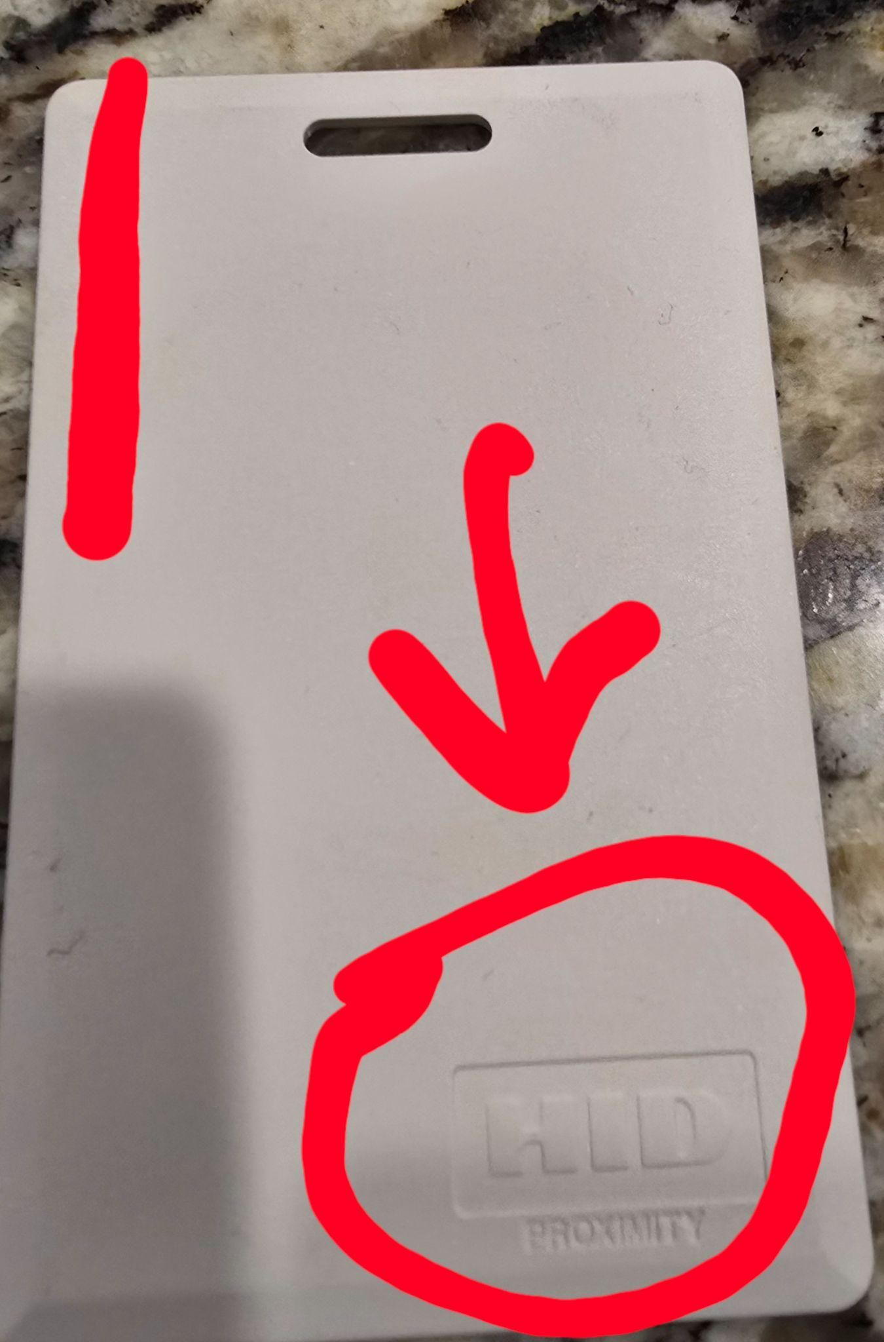


2025 New Procedures
New property management
Associa HRW: 919-787-9000
ADT - New pool cards will be mailed
New Pool Security
🏊
Landscaping Contract Bids
Request for bids has begun
Notes:
Presenter: Greg

Slide 7


2024 Accomplishments
Community Improvements
Community Events
New pool furniture
New door locking mechanism (motion detection)
New ceiling fans
Pool deck resurfaces
(8 year warranty)
New attorney’s office selected
Community Clean Up Day
Pool Grand Re-Opening
DJ Inferno
Music Bingo
Halloween Decorating Contest
Holiday Decorating Contest
Notes:
Presenter: Greg

Slide 8
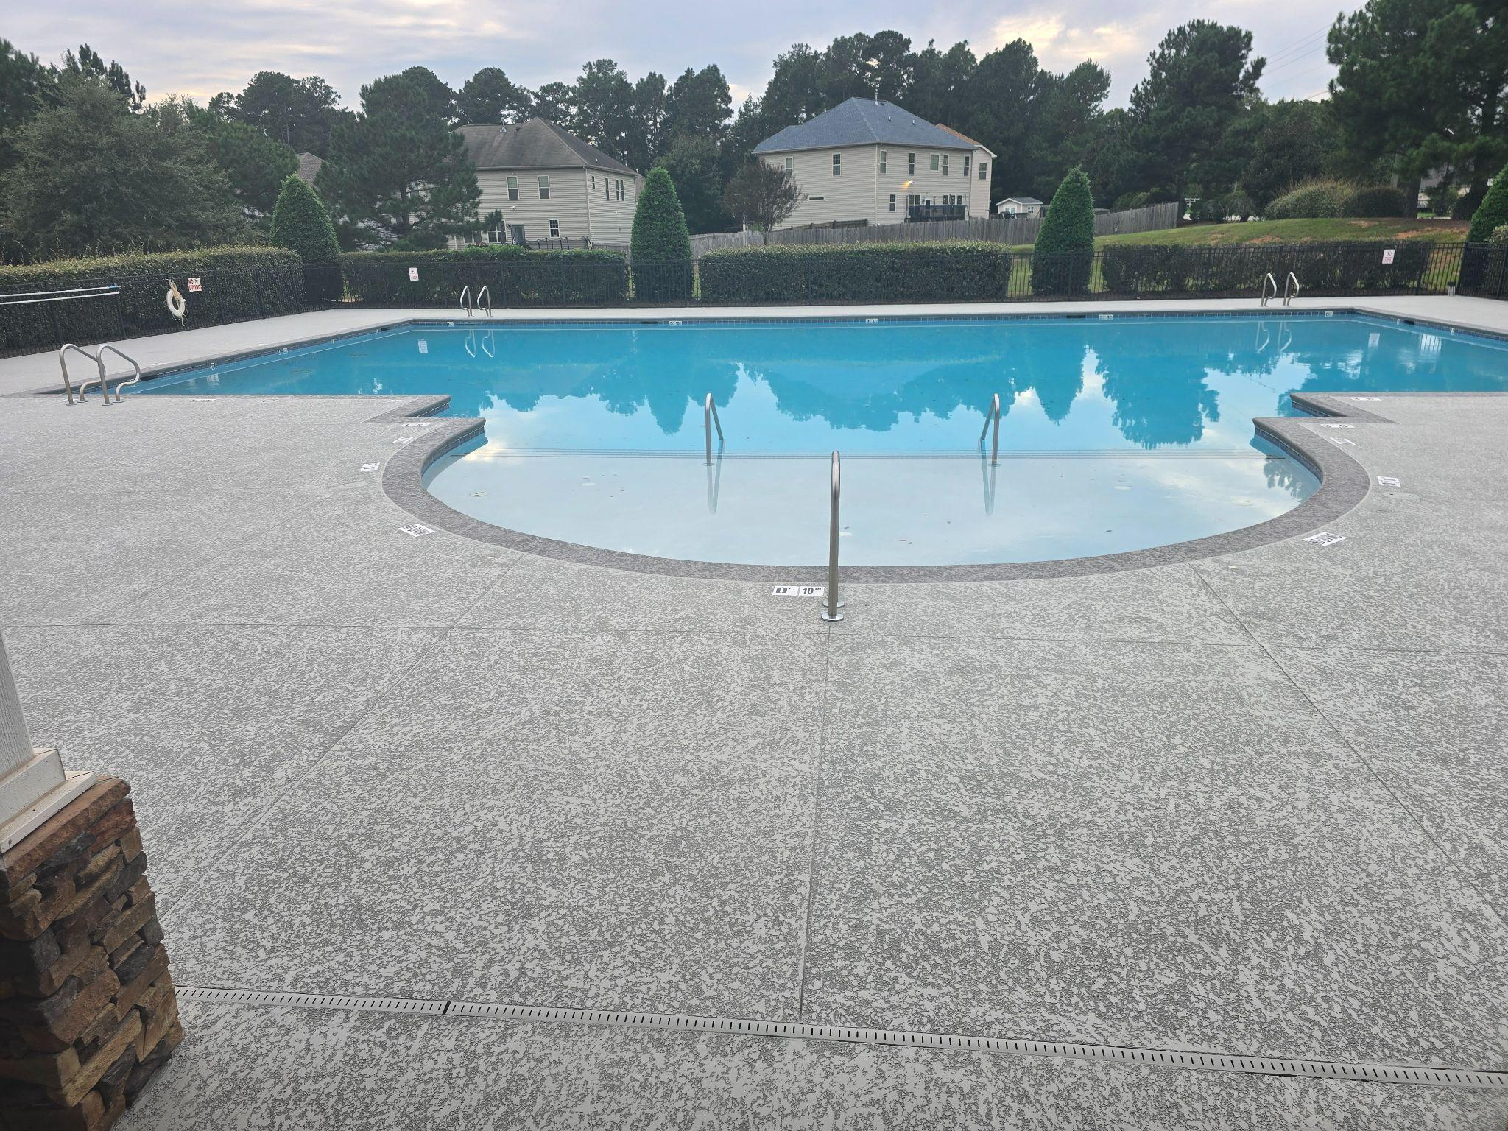
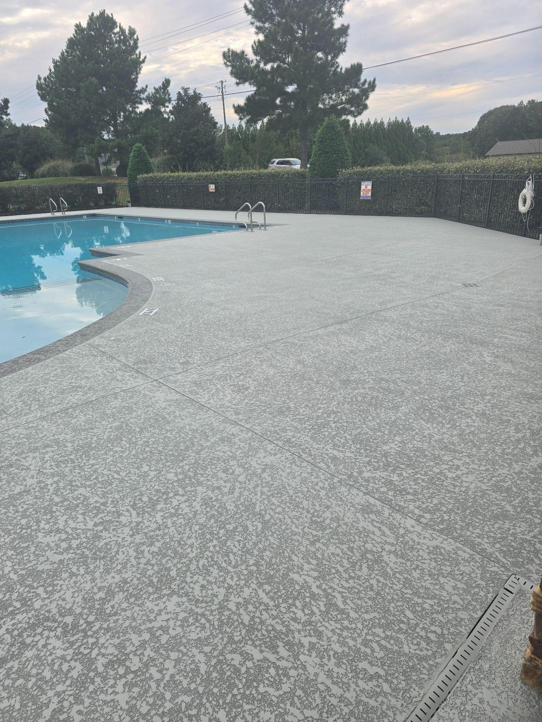
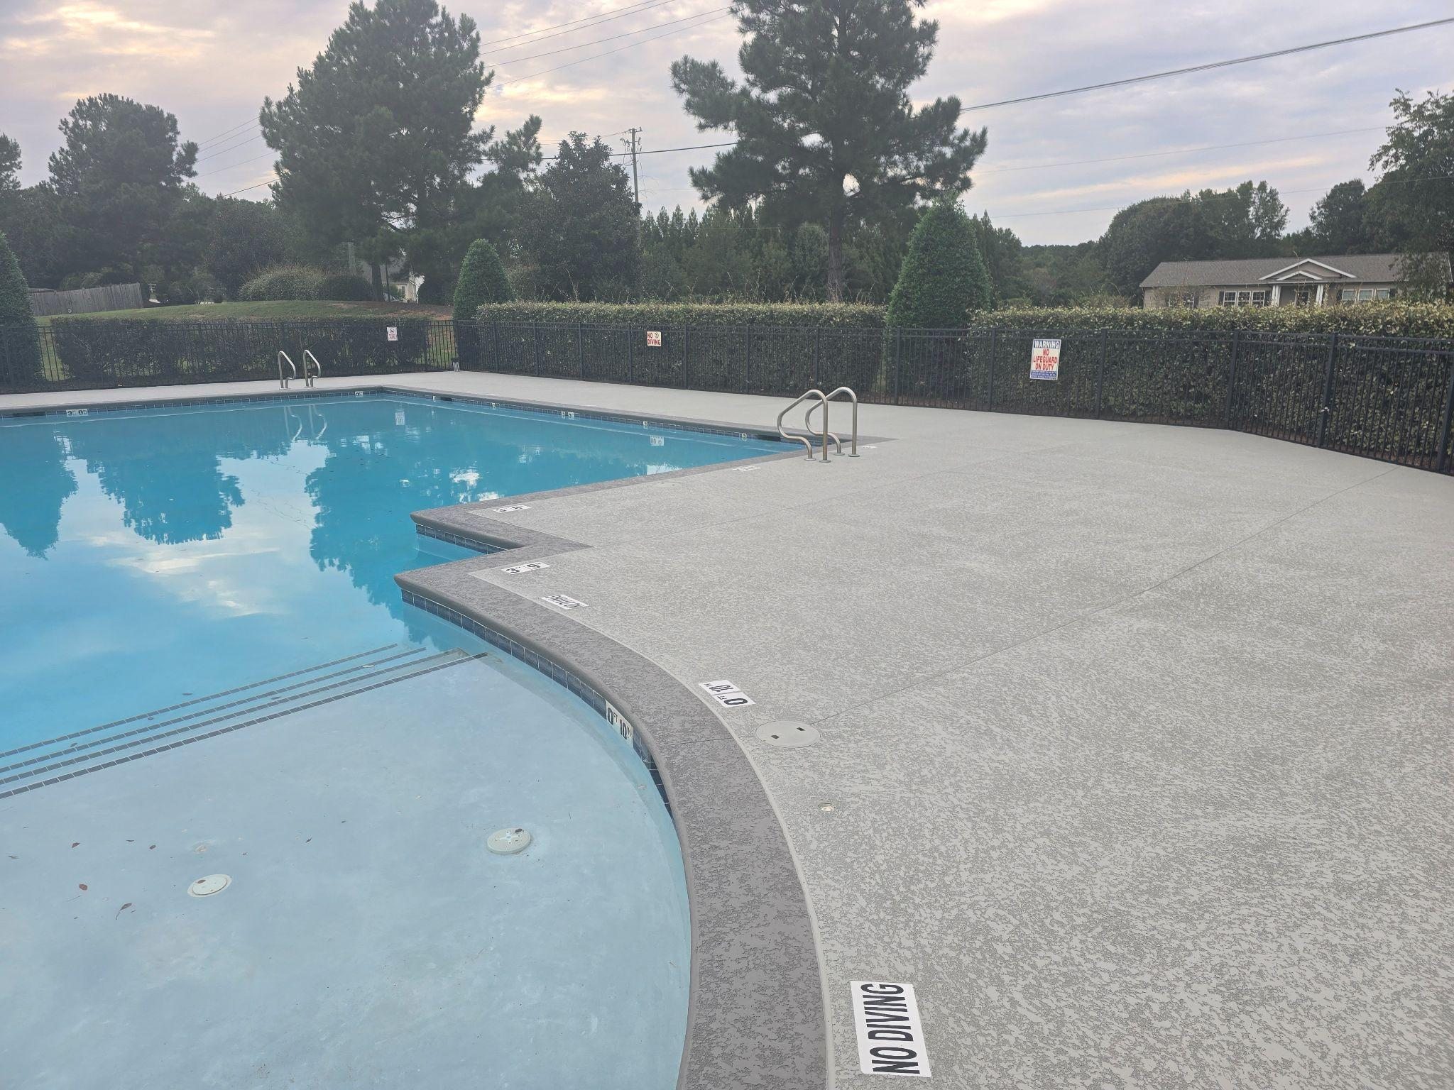
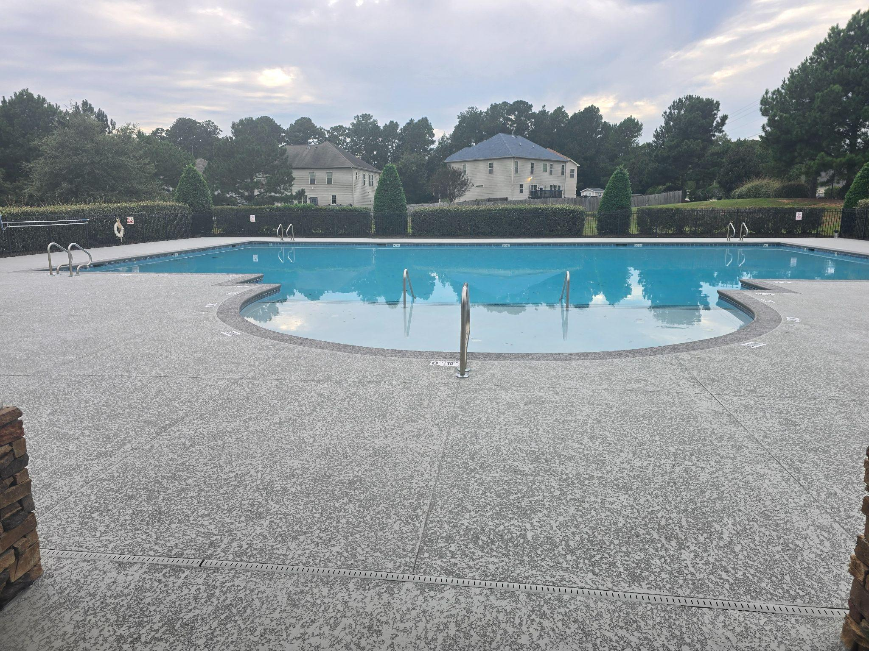
Summerlyn Pool 2025
8
Cool Deck Coating for Reduced Heat Absorption

Slide 9
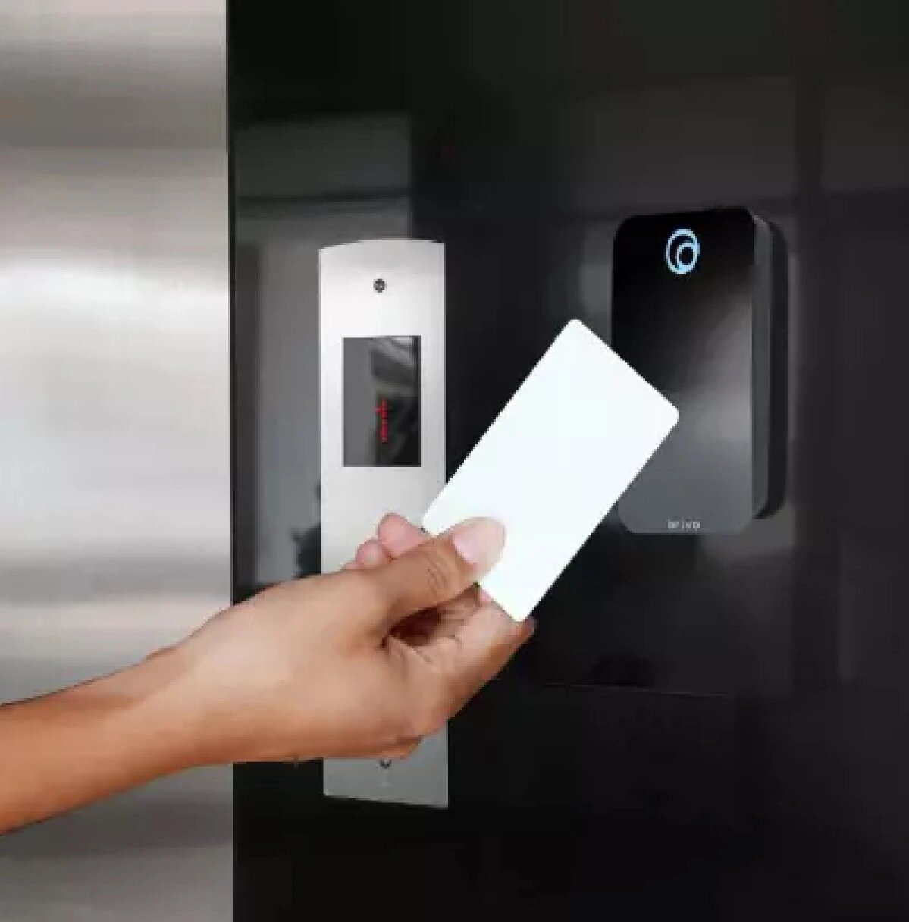
Pool Access Control 2025
9
Powered by Brivo
Updated technology
Lower card fail rate
Remote access and repair available

Slide 10
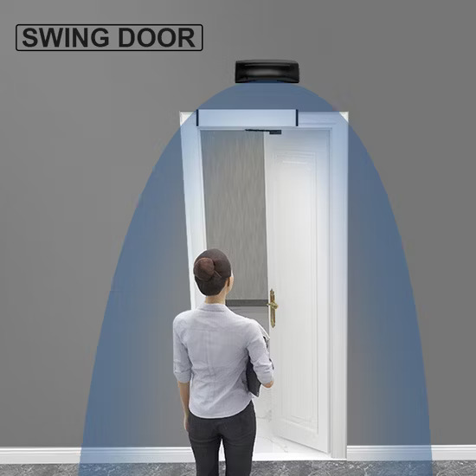
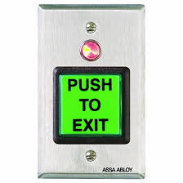
Pool Access Control 2025
10
Motion detection enabled to exit
Ease of access
Door relocks after 3 seconds

Slide 11





Short Term Goals (1-3 Years)
Repairing Greenway Trail as budget allows
Covenant Compliance
Parking, powerwashing, mailboxes, fences, etc.
ARC Awareness & Adherence
Don’t Know if ARC Approval is Needed? Submit to be Safe
Townsquare involvement
Logging on Townsquare and getting set up in the system
Community Involvement (Events, lost dogs, safety)
Notes:
Presenter: Sally

Slide 12
HOA Budget
Notes:
Presenter: Kristie

Slide 13
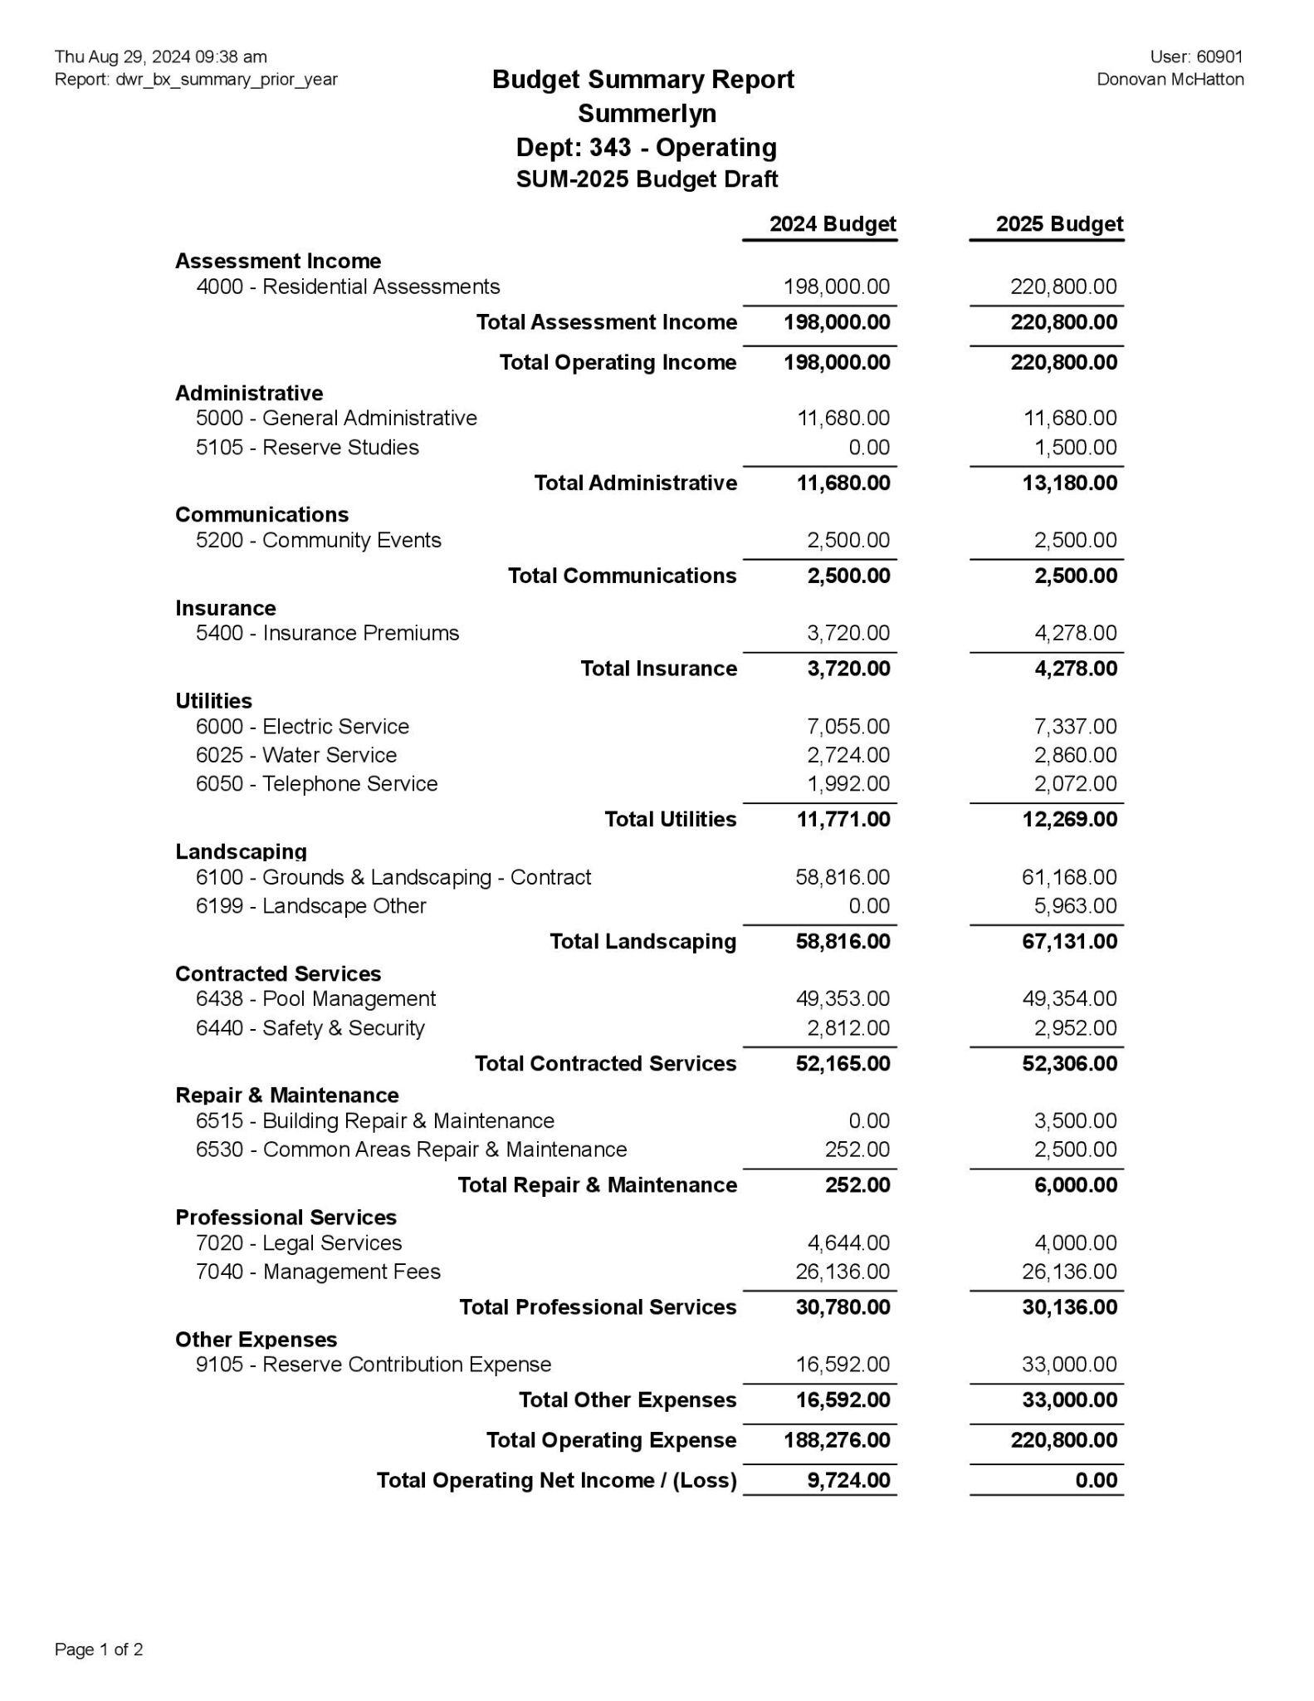
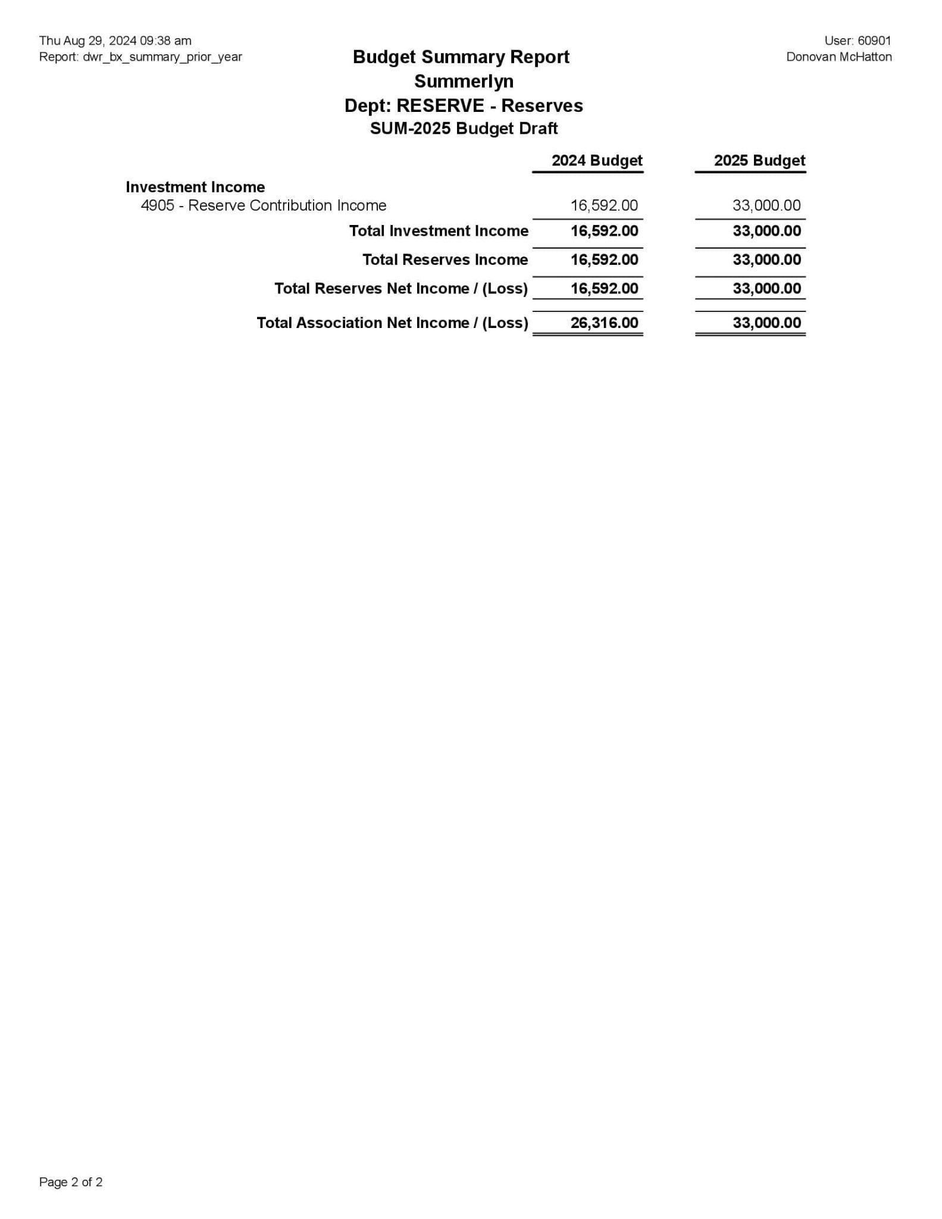
2025 Budget Review:
Assessments

Slide 14

Reserve Projects
Notes:
Presenter: Greg

Slide 15

Reserve Projects
Pool deck resurfacing completed
Continue with the Greenway Repairs as the Budget Allows
Deep trim of bushes along Glen Laurel
Deep trim of wood line along Greenway.
Reserve study recommended for 2026
Notes:
Presenter: Greg

Slide 16

Architectural Review Committee
Notes:
Speaker: ARC Committee

Slide 17
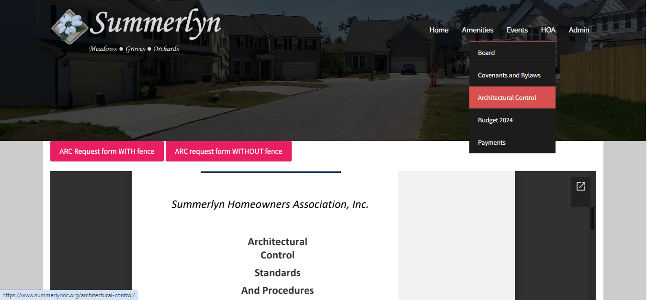
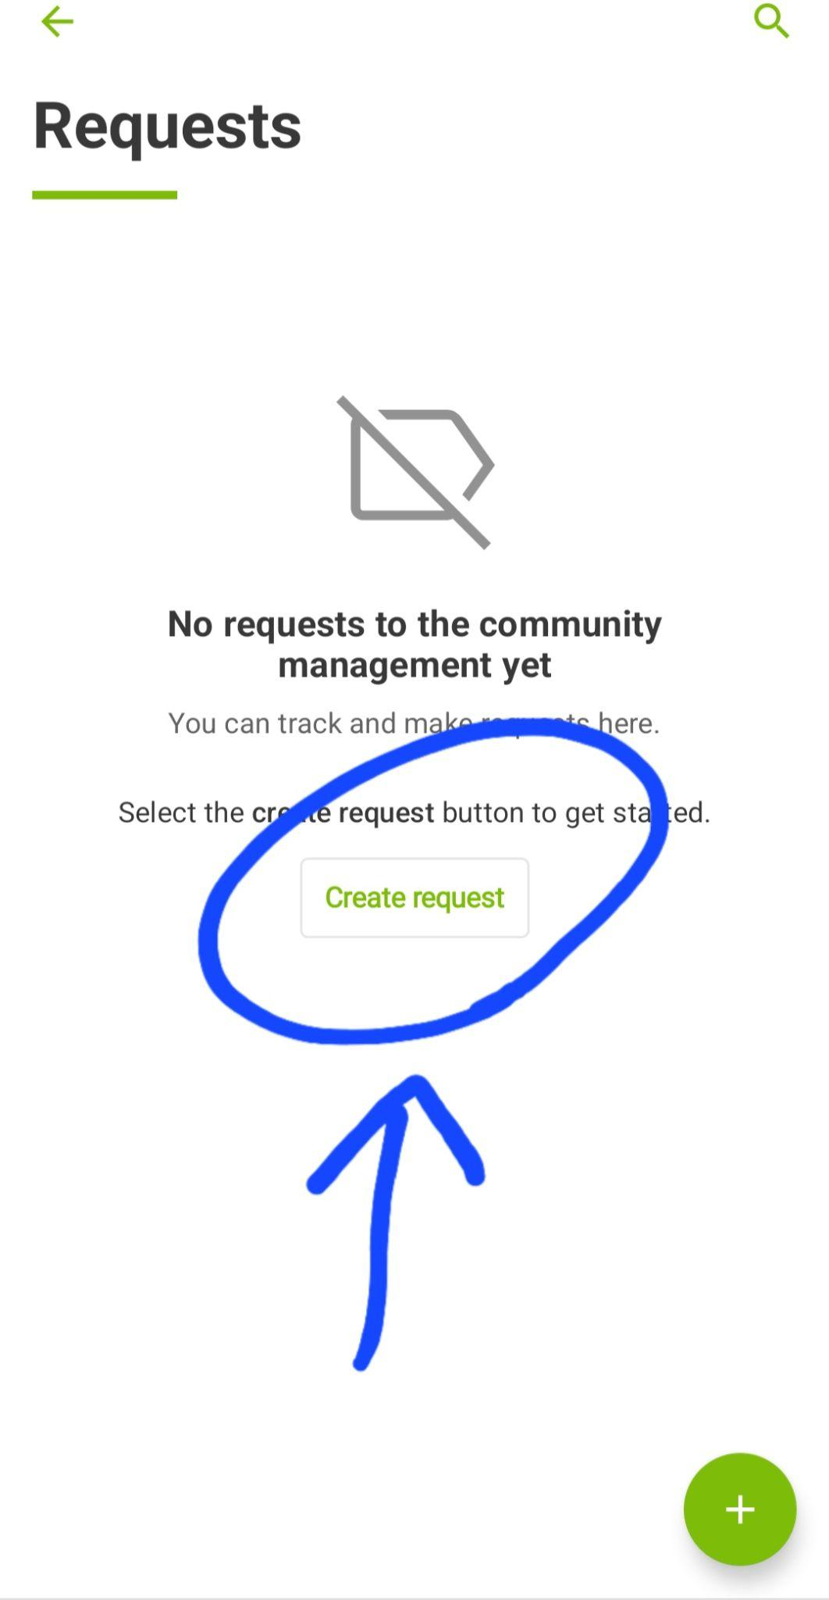
Summerlyn ARC Submission Process
17
OR
Notes:
Presenter: ARC Committee

Slide 18
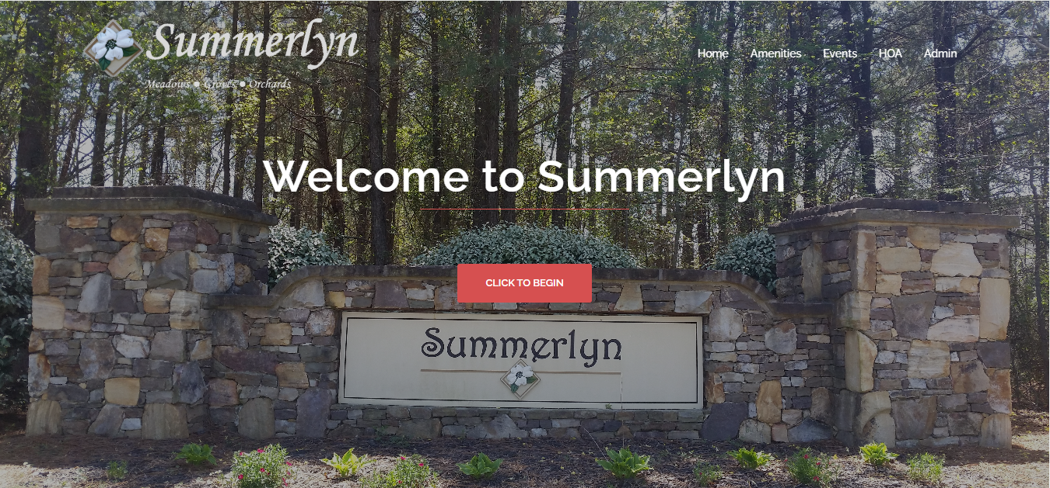
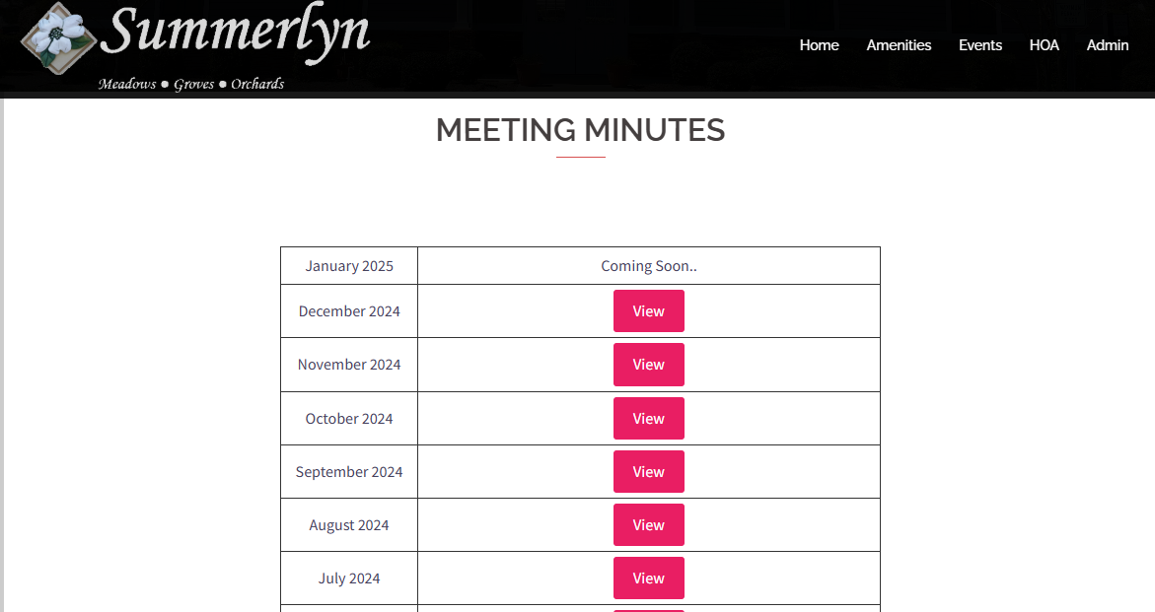
Summerlynnc.org
18
Events
Meeting Minutes
ARC Forms
Pool Key request form
Covenants
Mailing address for checks

Slide 19
Board Membership Voting
Notes:
Presenter: Colie

Slide 20
Board of Directors - Openings
Sonya McLean
Paul Rosales
Bill Vitellaro
George Concepcion
Walter Serrano
VACANT
VACANT
Notes:
Presenter: Colie

Slide 21
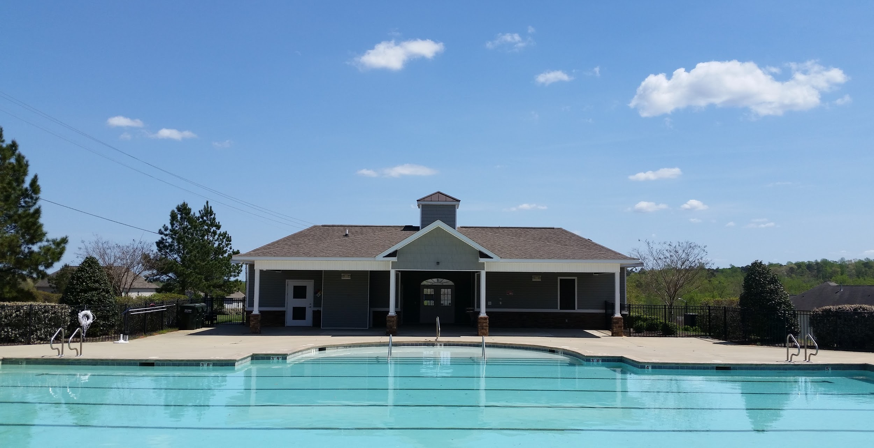


20
THANK YOU FOR JOINING US!
QUESTIONS AND COMMENTS
Notes:
Presenter: Colie

