Slide 1




Summerlyn HOA
Annual Meeting
January 18, 2024
Notes:
Presenter: Sally/Colie

Slide 2
Agenda
Introductions - Colie from RM and Current Board of Directors
Challenges, Accomplishments, & Goals
HOA Budget Review
Community Awareness
Reserve Projects
Architectural Review Committee
Board Membership Voting
Notes:
Presenter: Sally

Slide 3

Introductions
Notes:
Presenter: Sally

Slide 4
Board of Directors
Sally King
President
Greg Forde
Vice President
Kristie Linder
Treasurer
Chris Allard
ARC Committee
Bill Vitellaro
ARC Committee
Crystal Dale
ARC Committee
George Concepcion
Secretary
Committees:
Social/Community
Beautification
Pool
Security
Landscaping
Others as needed
Notes:
ALL

Slide 5
Challenges, Accomplishments & Goals
Notes:
Presenter: Greg

Slide 6
2023 Challenges
Covenant Adherence
Street Parking Complaints
Outstanding HOA Dues
Pool Management Company Standards
Landscaping Contract Bids
New Attorney
Notes:
Presenter: Greg

Slide 7
2023 Accomplishments
Community Improvements
New pool furniture
Community Events
Pool Grand Re-Opening
Sand filter replaced at pool
New hot water heater, Jan 2023
Pool deck power washed
Landscaping bids
New attorney’s office selected
Trivia Night
Music Bingo
Community Clean Up Day
Halloween Decorating Contest
Holiday Decorating Contest
Notes:
Presenter: Greg

Slide 8
Short Term Goals (1-3 Years)
Increased Community Involvement
We Need Everyone to be Involved
ARC Awareness & Adherence
Don’t Know if ARC Approval is Needed? Submit to be Safe
Glen Laurel Crosswalk
Currently, this is pending with the Town of Clayton. As they must put in a sidewalk on the opposing side.
Continue with the Greenway Repairs as the Budget Allows
Resurfacing of the pool deck
Notes:
Presenter: Sally

Slide 9
HOA Budget
Notes:
Presenter: Kristie

Slide 10
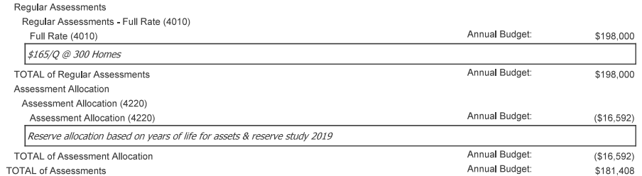
2024 Budget Review:
Assessments
Notes:
Presenter: Kristie

Slide 11
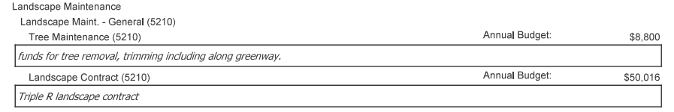
2024 Budget Review:
Direct Operating Expenses – Landscape Maintenance & Contract
Funds allocated to trimming along the greenway in 2024.
Notes:
Presenter: Kristie

Slide 12
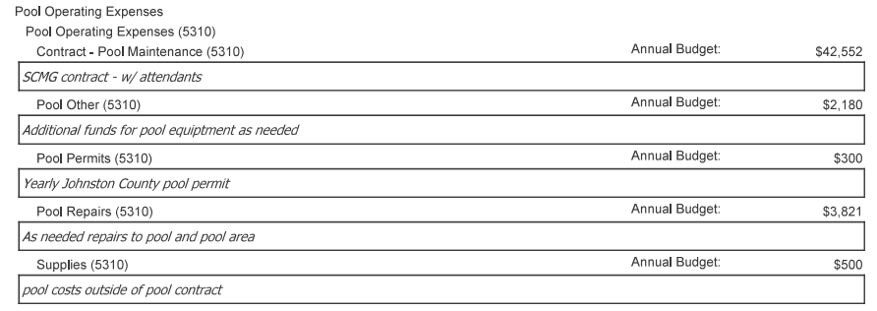
2024 Budget Review:
Direct Operating Expenses -
Pool Operating
Contract
Pool Other – Misc. Items
Permits
Repairs
Supplies outside of contract
Notes:
Presenter: Kristie

Slide 13
2024 Budget Review:
Direct Operating Expenses Continued
Total of Direct Operating Expenses: $ 123,004
Direct Operating Expenses also include:
    Keys and Locks Maintenance
    Security and Patrol
    Taxes
    Telephone (required at pool)
    Trash Removal
    Water and Wastewater
    Electricity
Notes:
Presenter: Kristie

Slide 14
2024 Budget Review:
General and Admin Expenses
Total of General and Administrative Expenses: $ 58,404
  Items include:
    Accounting
    Legal (Attorney outside of collections)
    Legal Collection Fee
    Homeowner Activities
    Insurance: General, Property & Liability
    Management Fee
    Administration: Coupon Books
    Administration: Misc.
Notes:
Presenter: Kristie

Slide 15

Community Awareness
Notes:
Presenter: Crystal

Slide 16
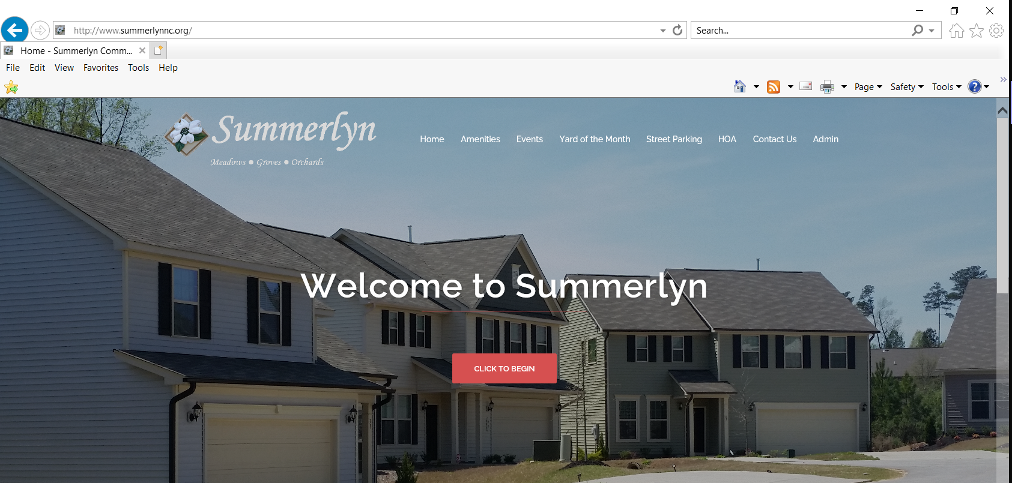
Communication
Official Summerlyn Website
  http://www.summerlynnc.org
Nextdoor
Facebook
  Summerlyn Subdivision-Clayton, NC
Community Email Blasts and Portal Announcements
Colie Botto, Property Manager
  SUMMERHA@CiraMail.com
  866-4-REALSERVICE (866-473-2573)
  www.realmanage.com
Notes:
Presenter: Crystal

Slide 17
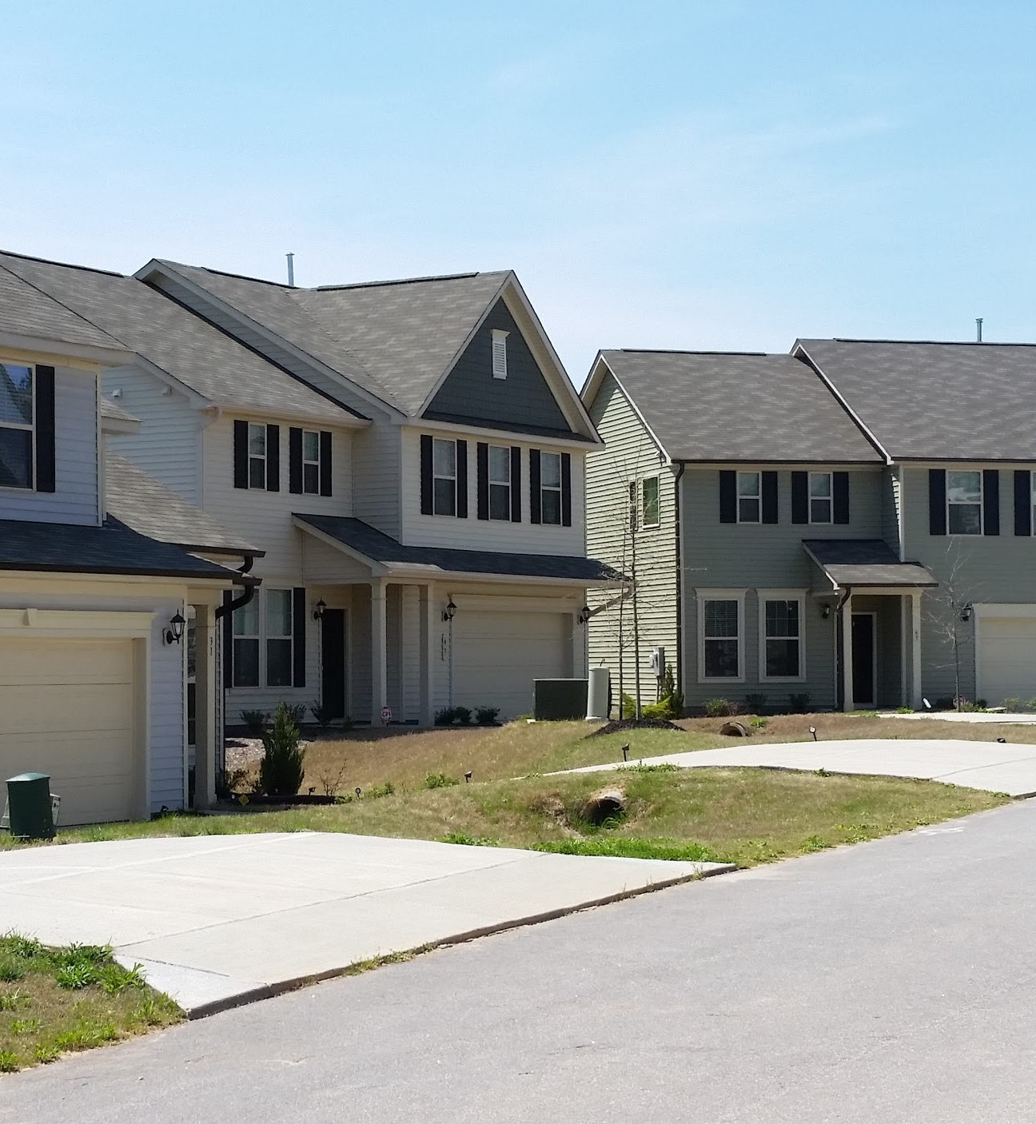
Resident Involvement
Committees
  Beautification
  Social
  Yard of the Month – Holiday Edition
  Community Engagement
Notes:
Presenter: Crystal

Slide 18

Reserve Projects
Notes:
Presenter: Greg

Slide 19

Reserve Projects
Pool deck resurfacing due to cracking of concrete resulting in major cost if not addressed. (1-2 years)
Continue with the Greenway Repairs as the Budget Allows
Deep trim of bushes along Glen Laurel
Deep trim of wood line along Greenway.
Notes:
Presenter: Greg

Slide 20

Architectural Review Committee
Notes:
Speaker: ARC Committee

Slide 21
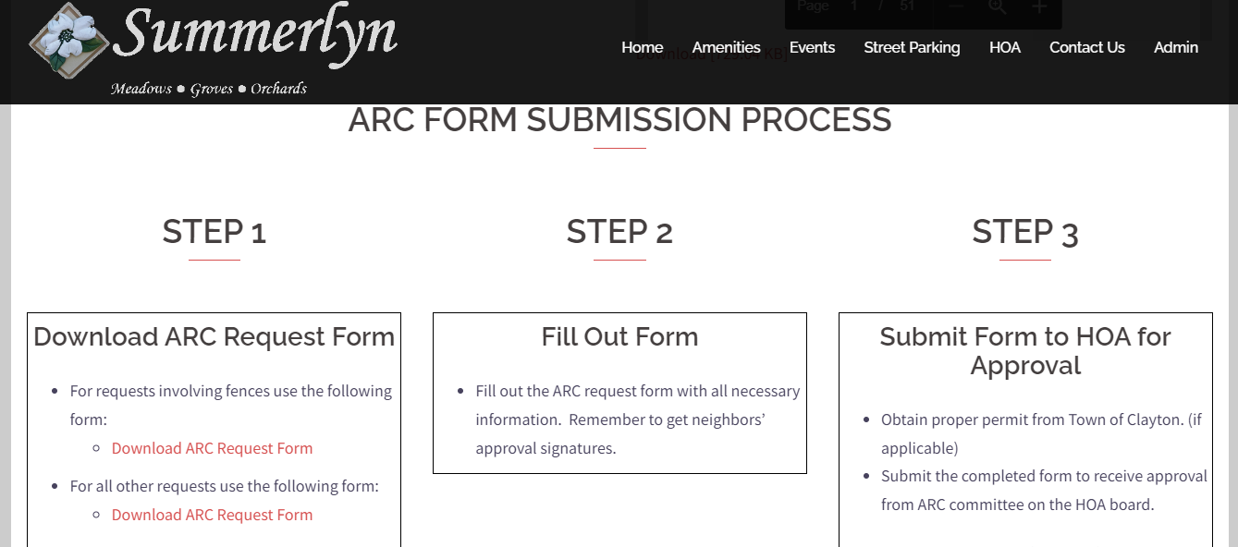
Summerlyn ARC Submission Process
Notes:
Presenter: ARC Committee

Slide 22
Board Membership Voting
Notes:
Presenter: Colie

Slide 23
Board of Directors - Openings
Greg Forde
Crystal Dale
Bill Vitellaro
George Concepcion
VACANT
VACANT
VACANT
Notes:
Presenter: Colie

Slide 24
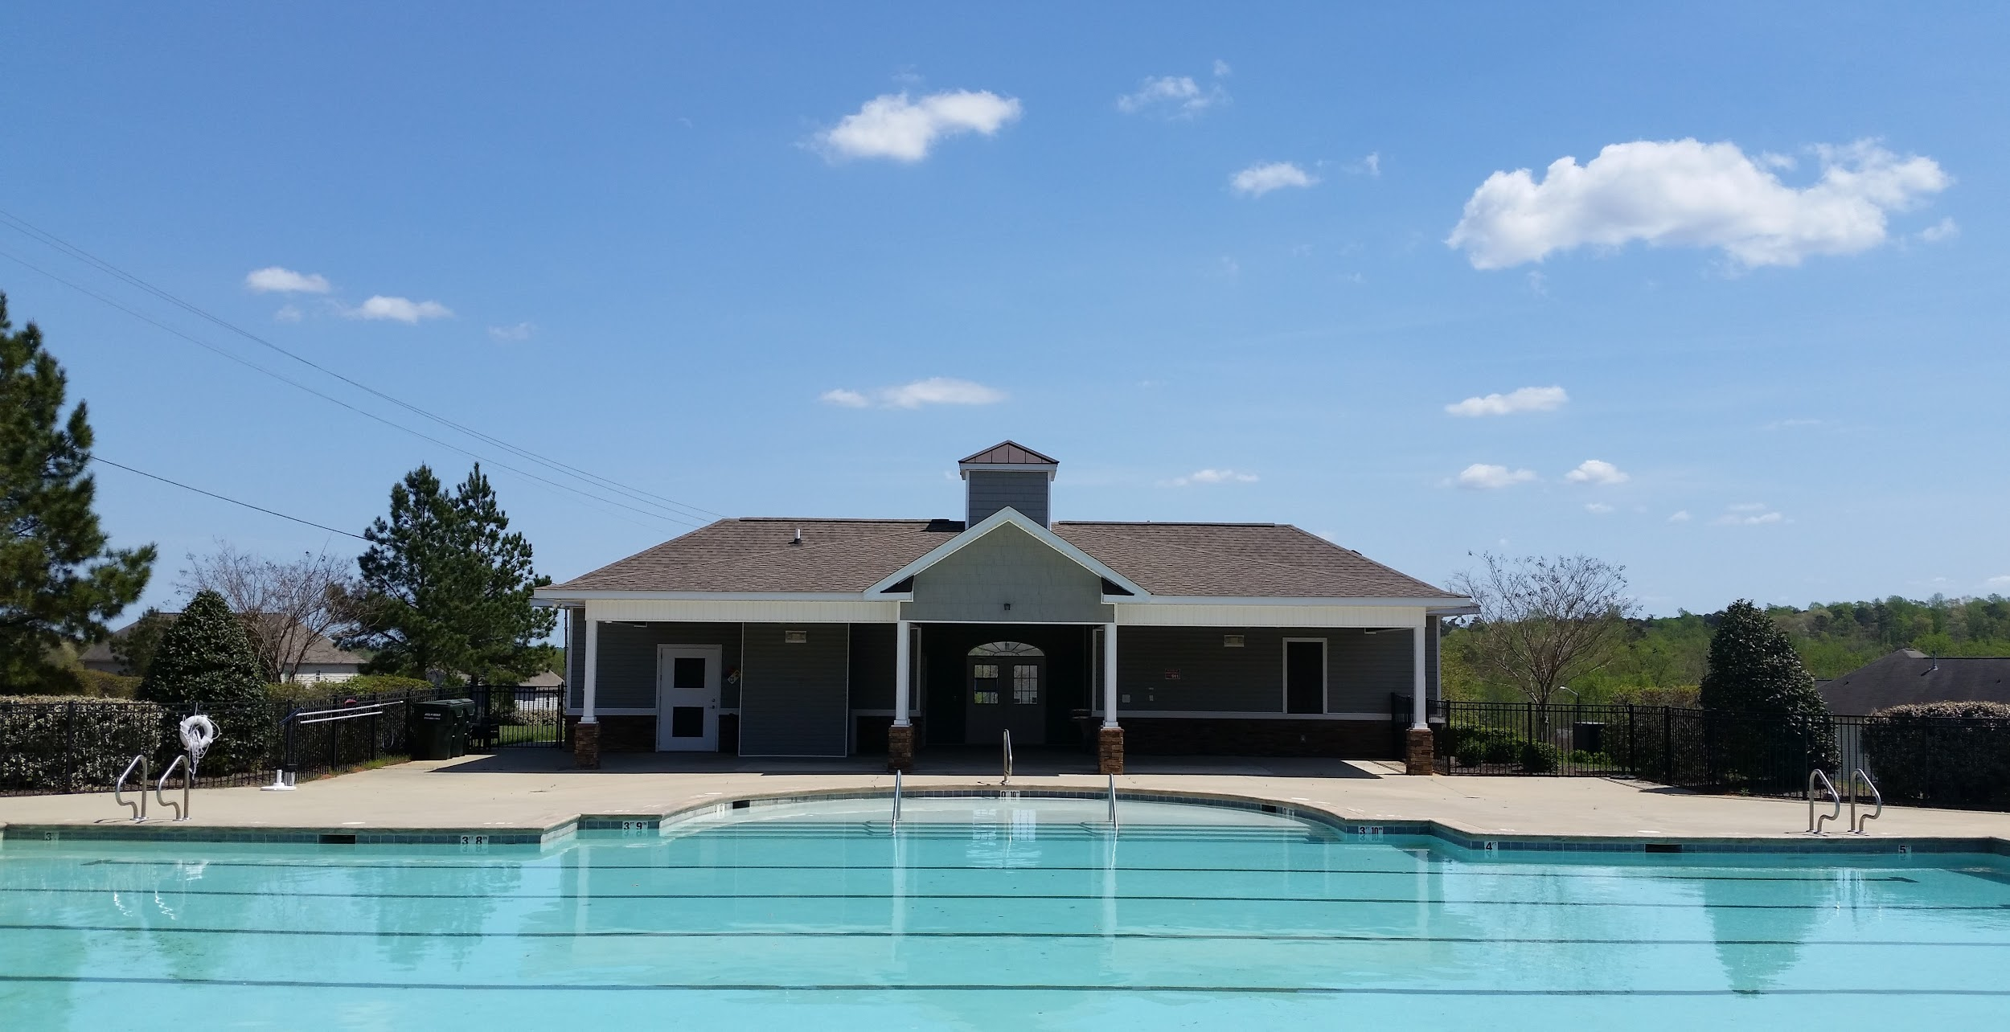
Thank You for Joining Us!
Questions and Comments
Notes:
Presenter: Colie

