Slide 1





Summerlyn HOA
Annual Meeting
January 17, 2023
Notes:
Presenter: Stephanie

Slide 2
Agenda
Introductions - Colie from RM and Current Board of Directors
Challenges, Accomplishments, & Goals
HOA Budget Review
Community Awareness
Reserve Projects
Architectural Review Committee
Board Membership Voting
Notes:
Presenter: Stephanie

Slide 3
Introductions
Notes:
Presenter: Stephanie

Slide 4
Board of Directors
Stephanie Lanier
President
Sally King
Vice President
Kristie Linder
Treasurer
Chris Allard
ARC Committee
Subhas Rai
ARC Committee
Matthew Boyle
ARC Committee
Committees:
Social/Community
Beautification
Pool
Security
Landscaping
Others as needed
Notes:
ALL

Slide 5
Challenges, Accomplishments & Goals
Notes:
Presenter: Stephanie

Slide 6
2022 Challenges
Pool Resurfacing Project
Covenant Adherence
Street Parking Complaints
Outstanding HOA Dues
Pool Management Company Standards
Communication w/ Town of Clayton Regarding the Crosswalk
Notes:
Presenter: Stephanie & ALL

Slide 7
2022 Accomplishments
Community Improvements
Sidewalk on Glen Laurel transferred to Town of Clayton.
Trespassing signage added to pool lot due to increased illegal activity overnight.
New timers for lights at pool.
Replacement of water heater.
Additional security camera installed.
Some bushes along Glen Laurel removed due to rapid overgrowth.
Pool Resurfacing project implemented and completed in September.
Seasonal Offerings
Spring Fling and Egg Hunt in April
Movie and Family Craft Night in September
Yard of the Month – Holiday Edition
Notes:
Presenter: Stephanie, Sally & Kristie

Slide 8
Short Term Goals (1-3 Years)
Increased Community Involvement
We Need Everyone to be Involved
ARC Awareness & Adherence
Don’t Know if ARC Approval is Needed? Submit to be Safe
Glen Laurel Crosswalk
Currently, this is pending with the Town of Clayton. As they must put in a sidewalk on the opposing side.
Continue with the Greenway Repairs as the Budget Allows
Bids for Landscaping Contracts
Notes:
Presenter: Steph to start, transitioning to others.

Slide 9
HOA Budget
Notes:
Presenter: Kristie

Slide 10
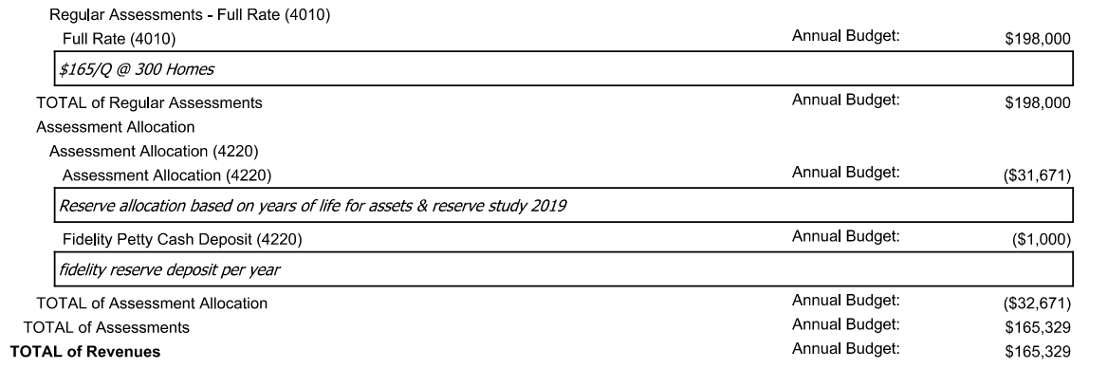
2023 Budget Review:
Assessments
Notes:
Presenter: Kristie

Slide 11
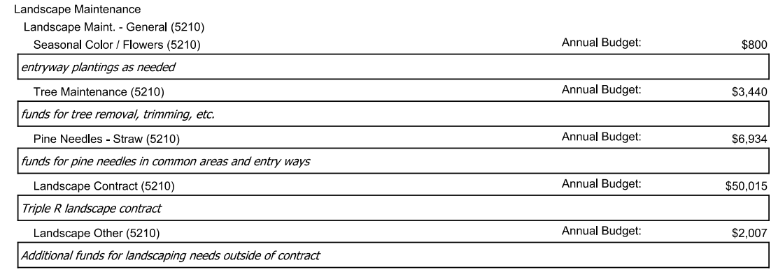
2023 Budget Review:
Direct Operating Expenses -
Landscape Maintenance
Notes:
Presenter: Kristie

Slide 12
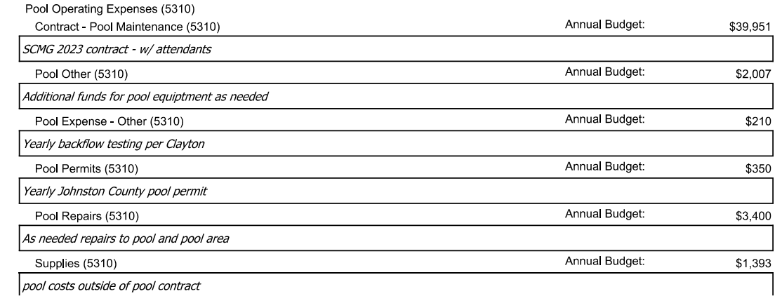
2023 Budget Review:
Direct Operating Expenses -
Pool Operating
Changes for 2023:
  New Pool Management Company
  Attendants 7 days per week.
Notes:
Presenter: Kristie

Slide 13
2023 Budget Review:
Direct Operating Expenses Continued
Total of Direct Operating Expenses: $126,949
  Direct Operating Expenses also include:
    Keys and Locks Maintenance
    Security and Patrol
    Taxes
    Telephone (required at pool)
    Trash Removal
    Water and Wastewater
    Electricity
Notes:
Presenter: Kristie

Slide 14
2023 Budget Review:
General and Admin Expenses
Total of General and Administrative Expenses: $38,380
  Items include:
    Accounting
    Legal (Attorney outside of collections)
    Legal Collection Fee
    Homeowner Activities
    Insurance: General, Property & Liability
    Management Fee
    Administration: Coupon Books
    Administration: Misc.
Notes:
Presenter: Kristie

Slide 15

Community Awareness
Notes:
Presenter: Sally

Slide 16
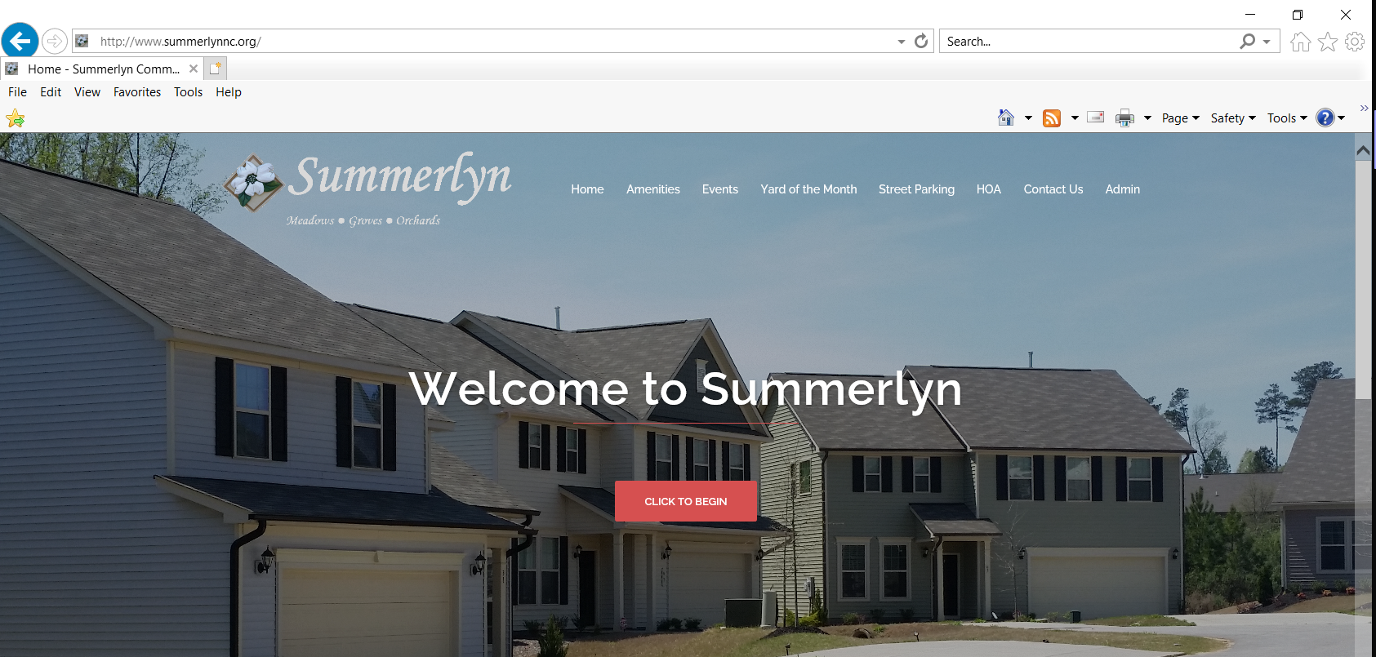
Communication
Official Summerlyn Website
  http://www.summerlynnc.org
Nextdoor
Facebook
  Summerlyn Subdivision-Clayton, NC
Community Email Blasts and Portal Announcements
Colie Botto, Property Manager
  SUMMERHA@CiraMail.com
  866-4-REALSERVICE (866-473-2573)
  www.realmanage.com
Notes:
Presenter: Sally

Slide 17
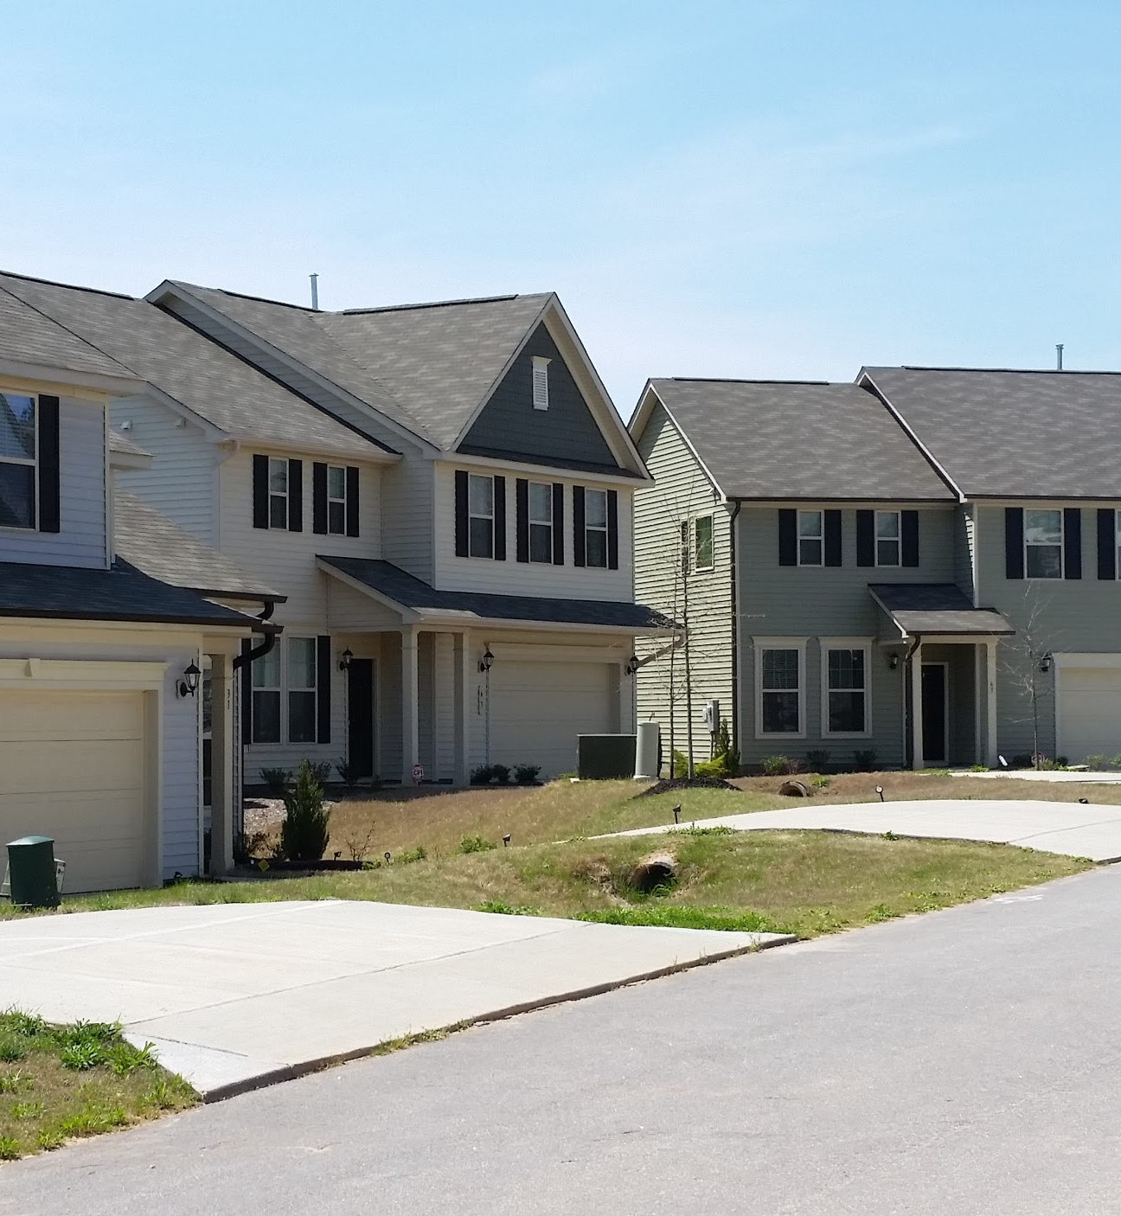
Resident Involvement
Committees
  Beautification
  Social
  Yard of the Month – Holiday Edition
  Community Engagement
Notes:
Presenter: Sally

Slide 18

Reserve Projects
Notes:
Presenter: Stephanie

Slide 19
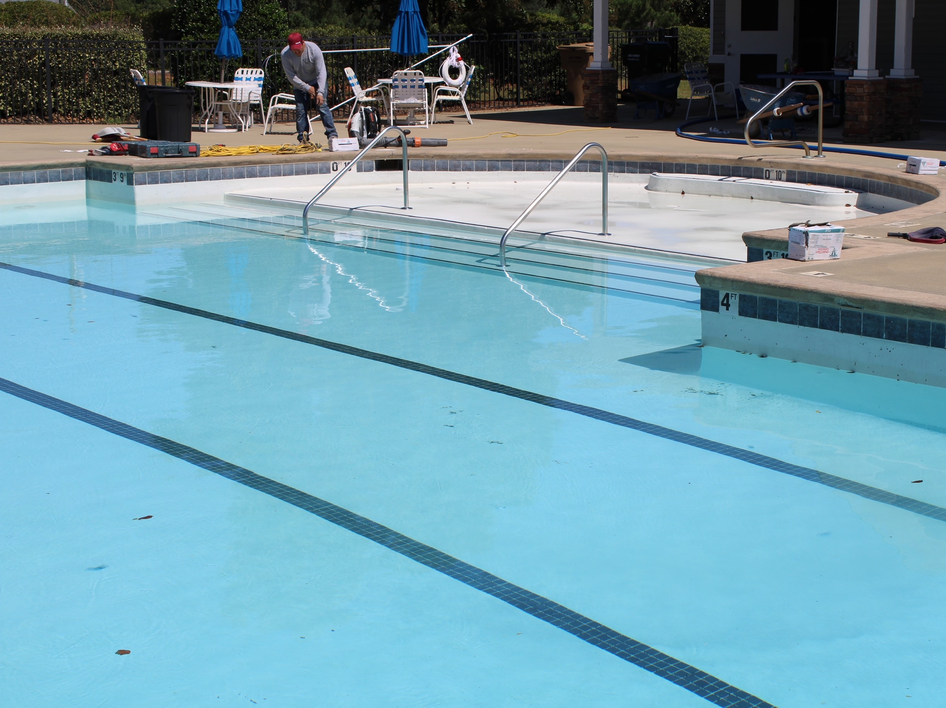
Pool Resurfacing Project
September 2022 the Summerlyn Pool received a facelift.
Notes:
Presenter: Chris A.

Slide 20
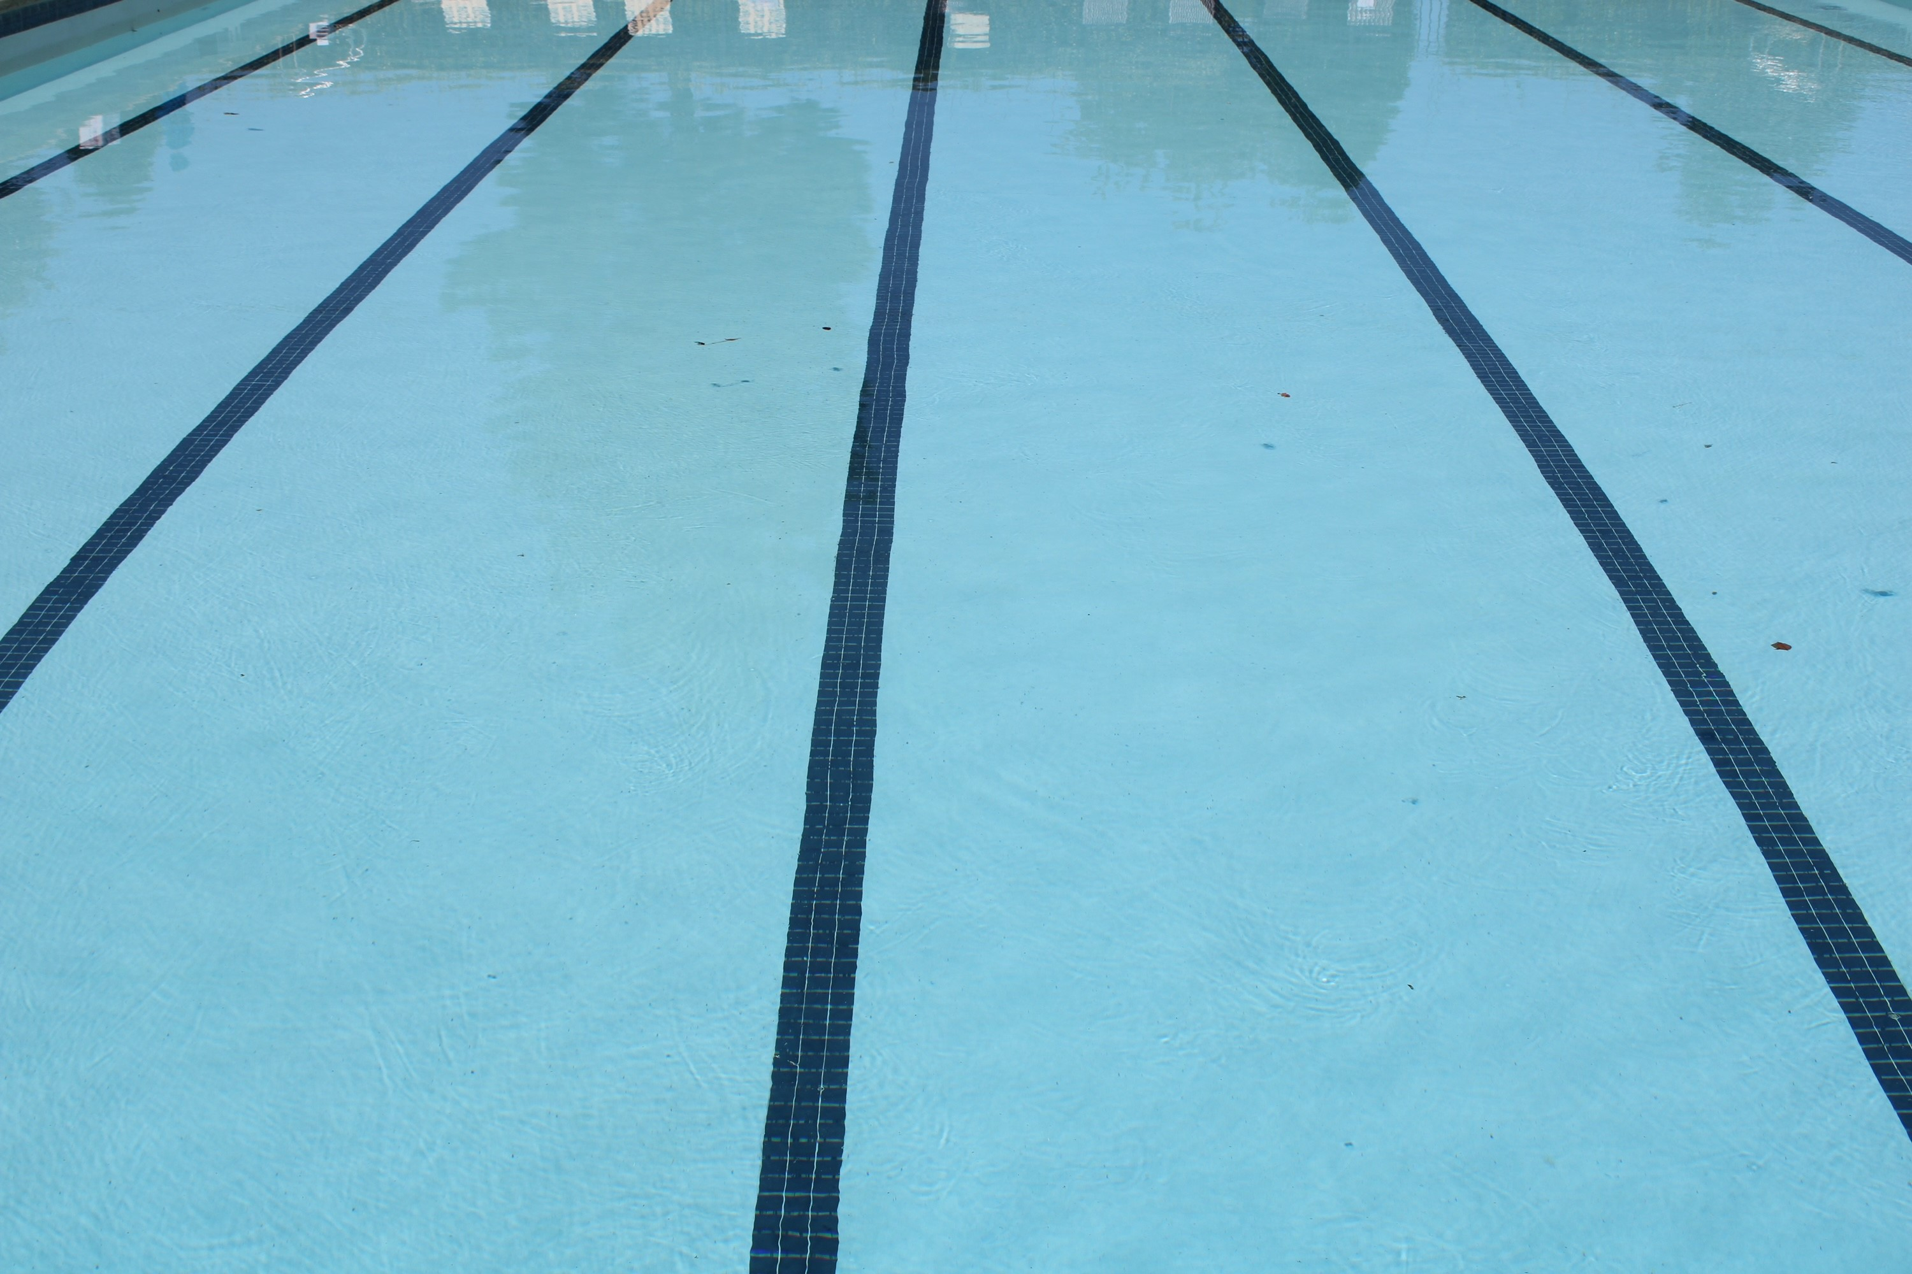
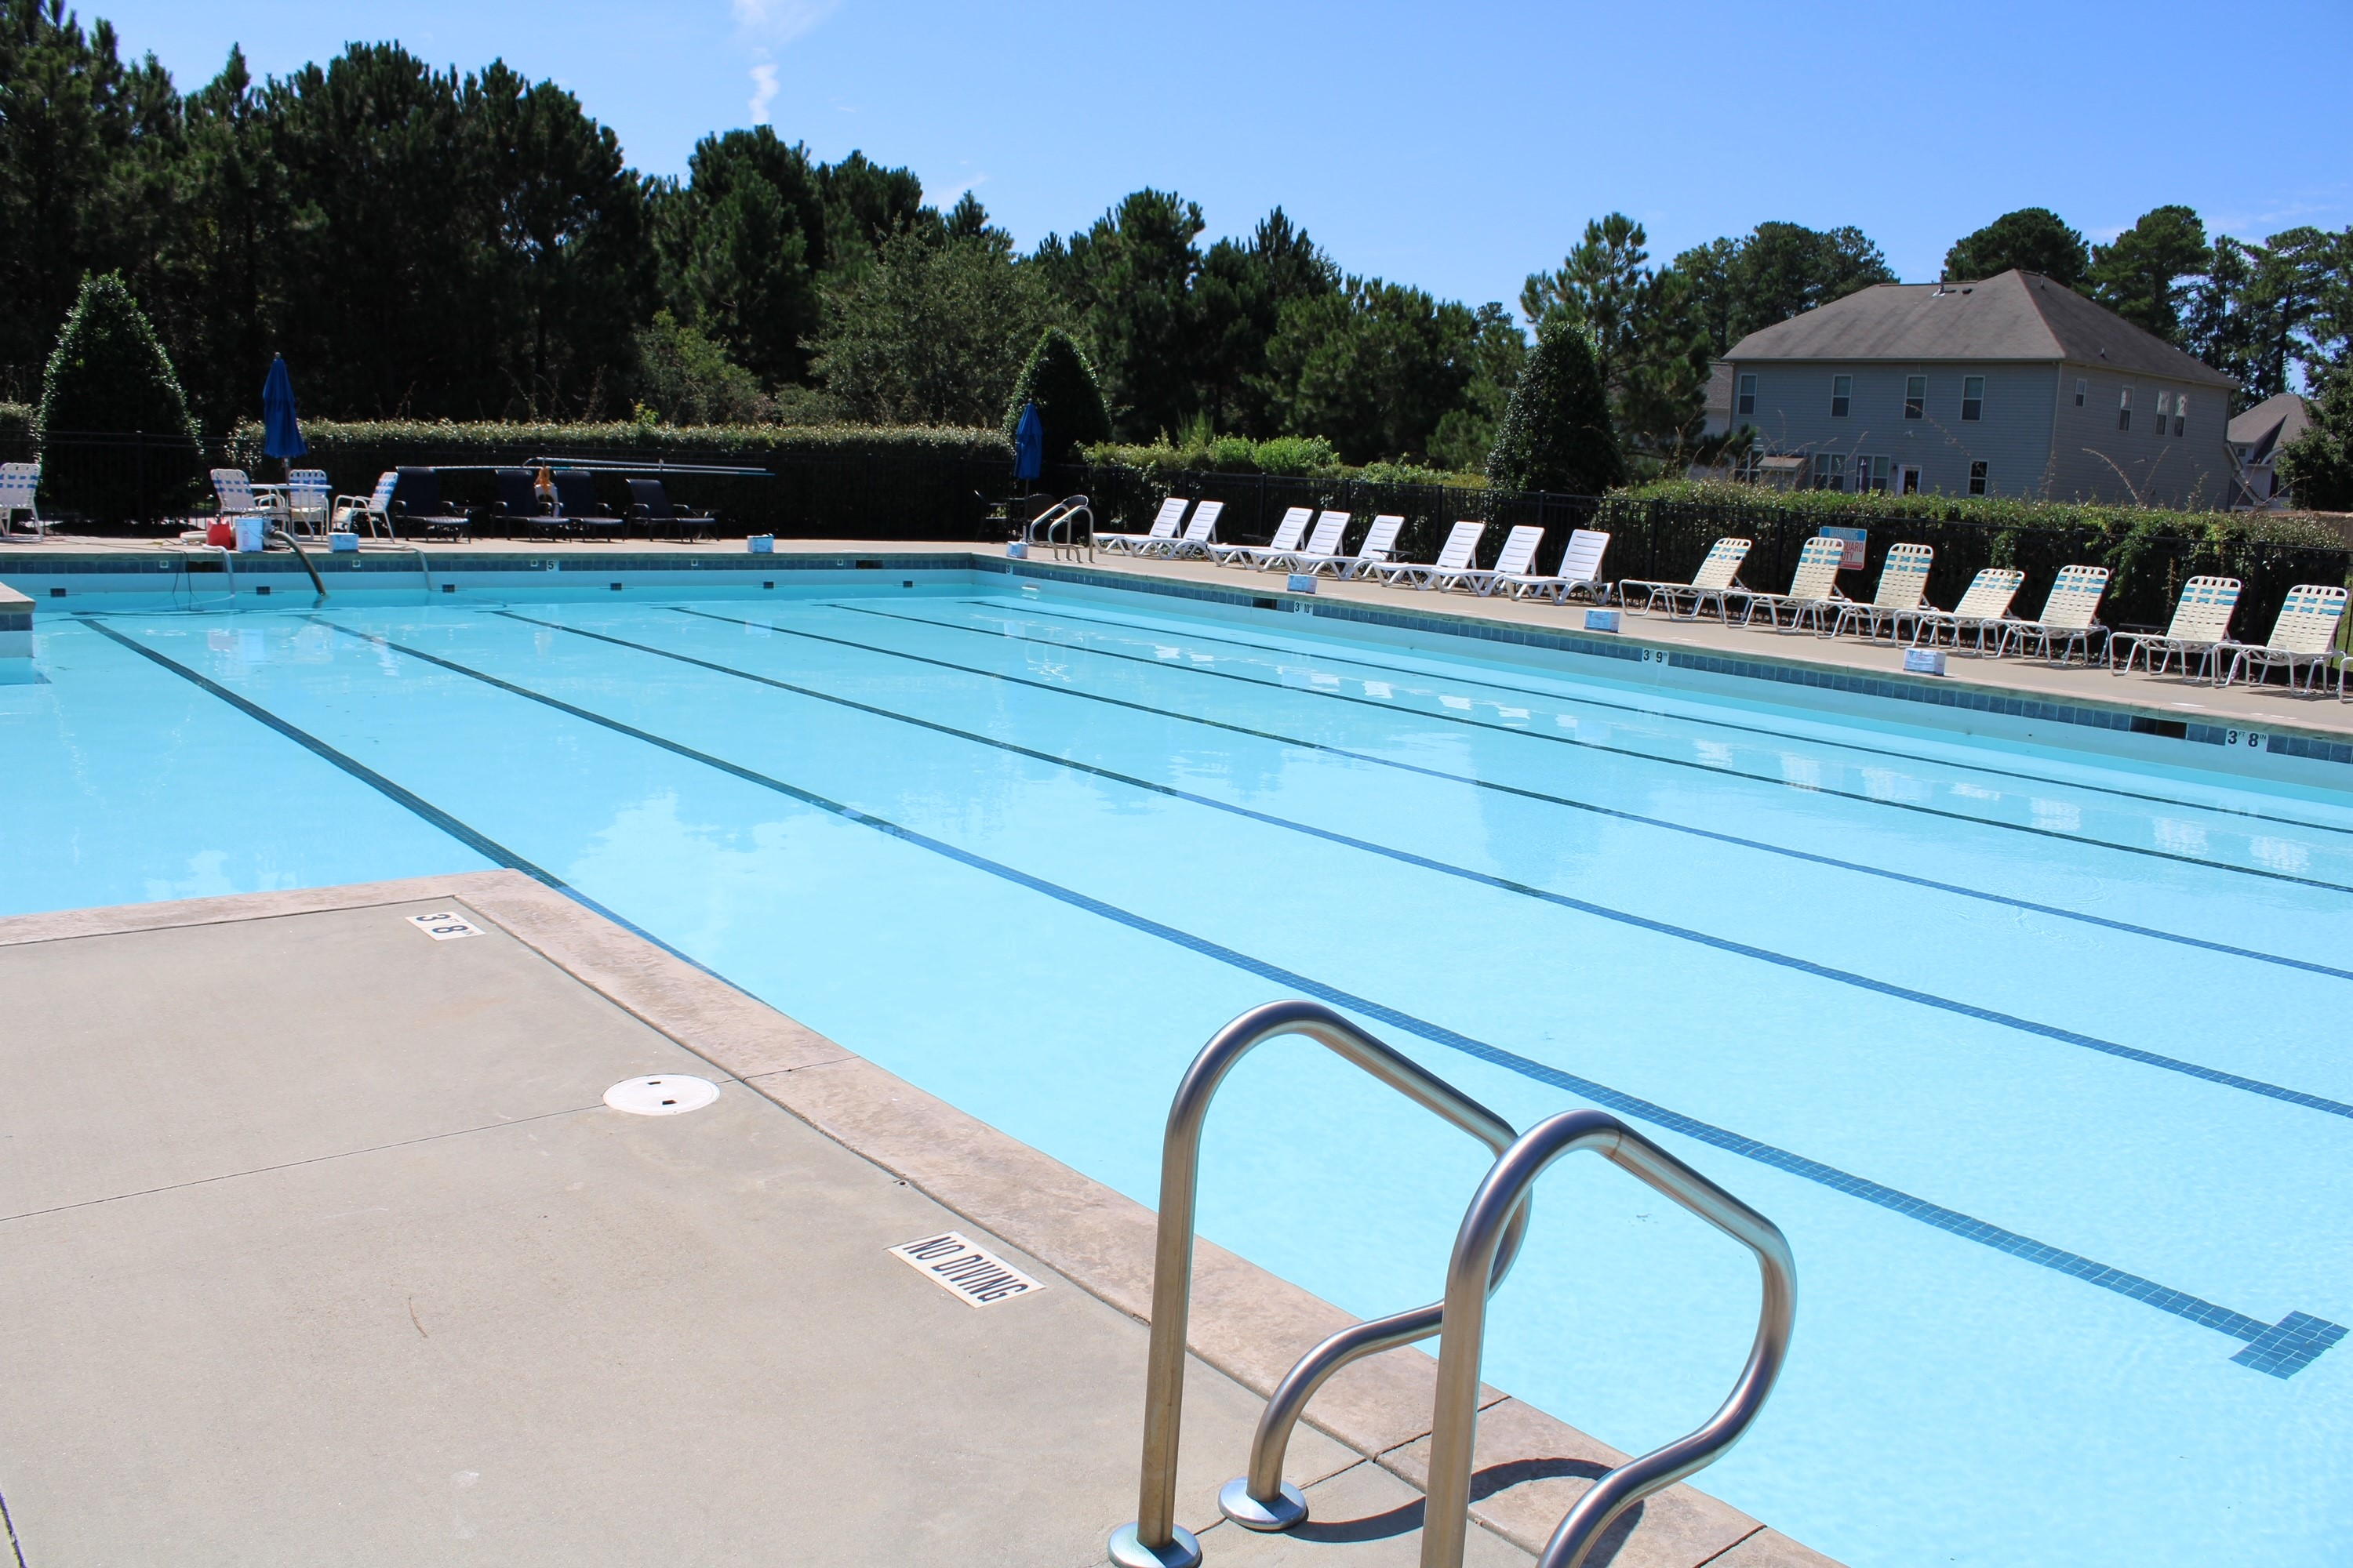
Pool Resurfacing Project
  Remove existing title and repair any damaged areas of bond beams behind existing tile.
  Chip out and grind underneath waterline tile, around returns, including main drains.
  Chip out existing hollow areas, acid wash and hydro blast the existing pool surface.
Notes:
Presenter: Chris A.

Slide 21
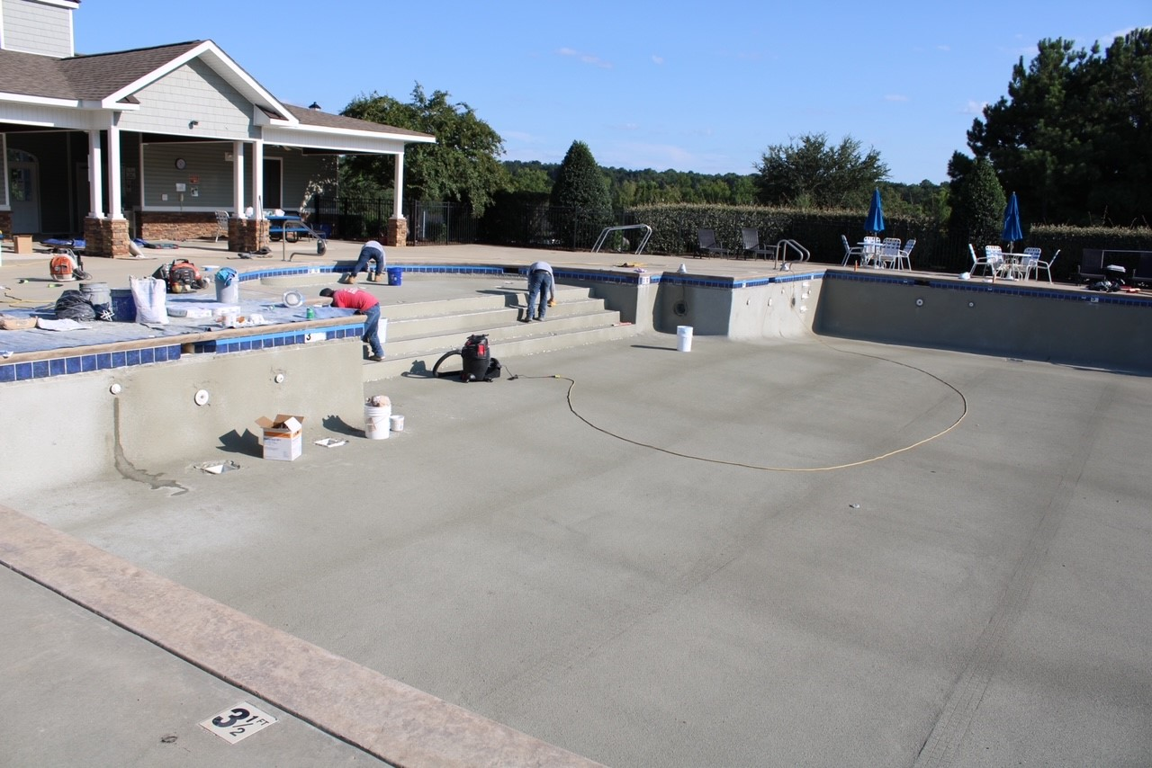
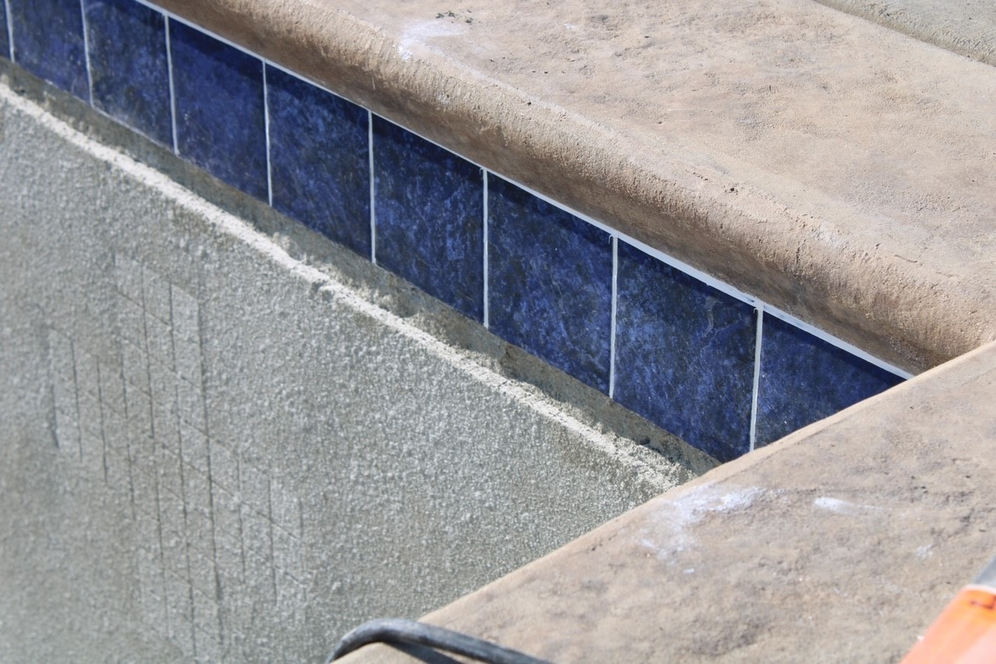
Pool Resurfacing Project
New water line tile and depth markers.
High quality urethan sealant between top of the new tile and coping. And bond-coat material added to pool surface.
New Quartz plaster sprayed into pool surface and cured.
New plaster surfaced brushed and balanced to scrub new surface.
Notes:
Presenter: Chris A.

Slide 22
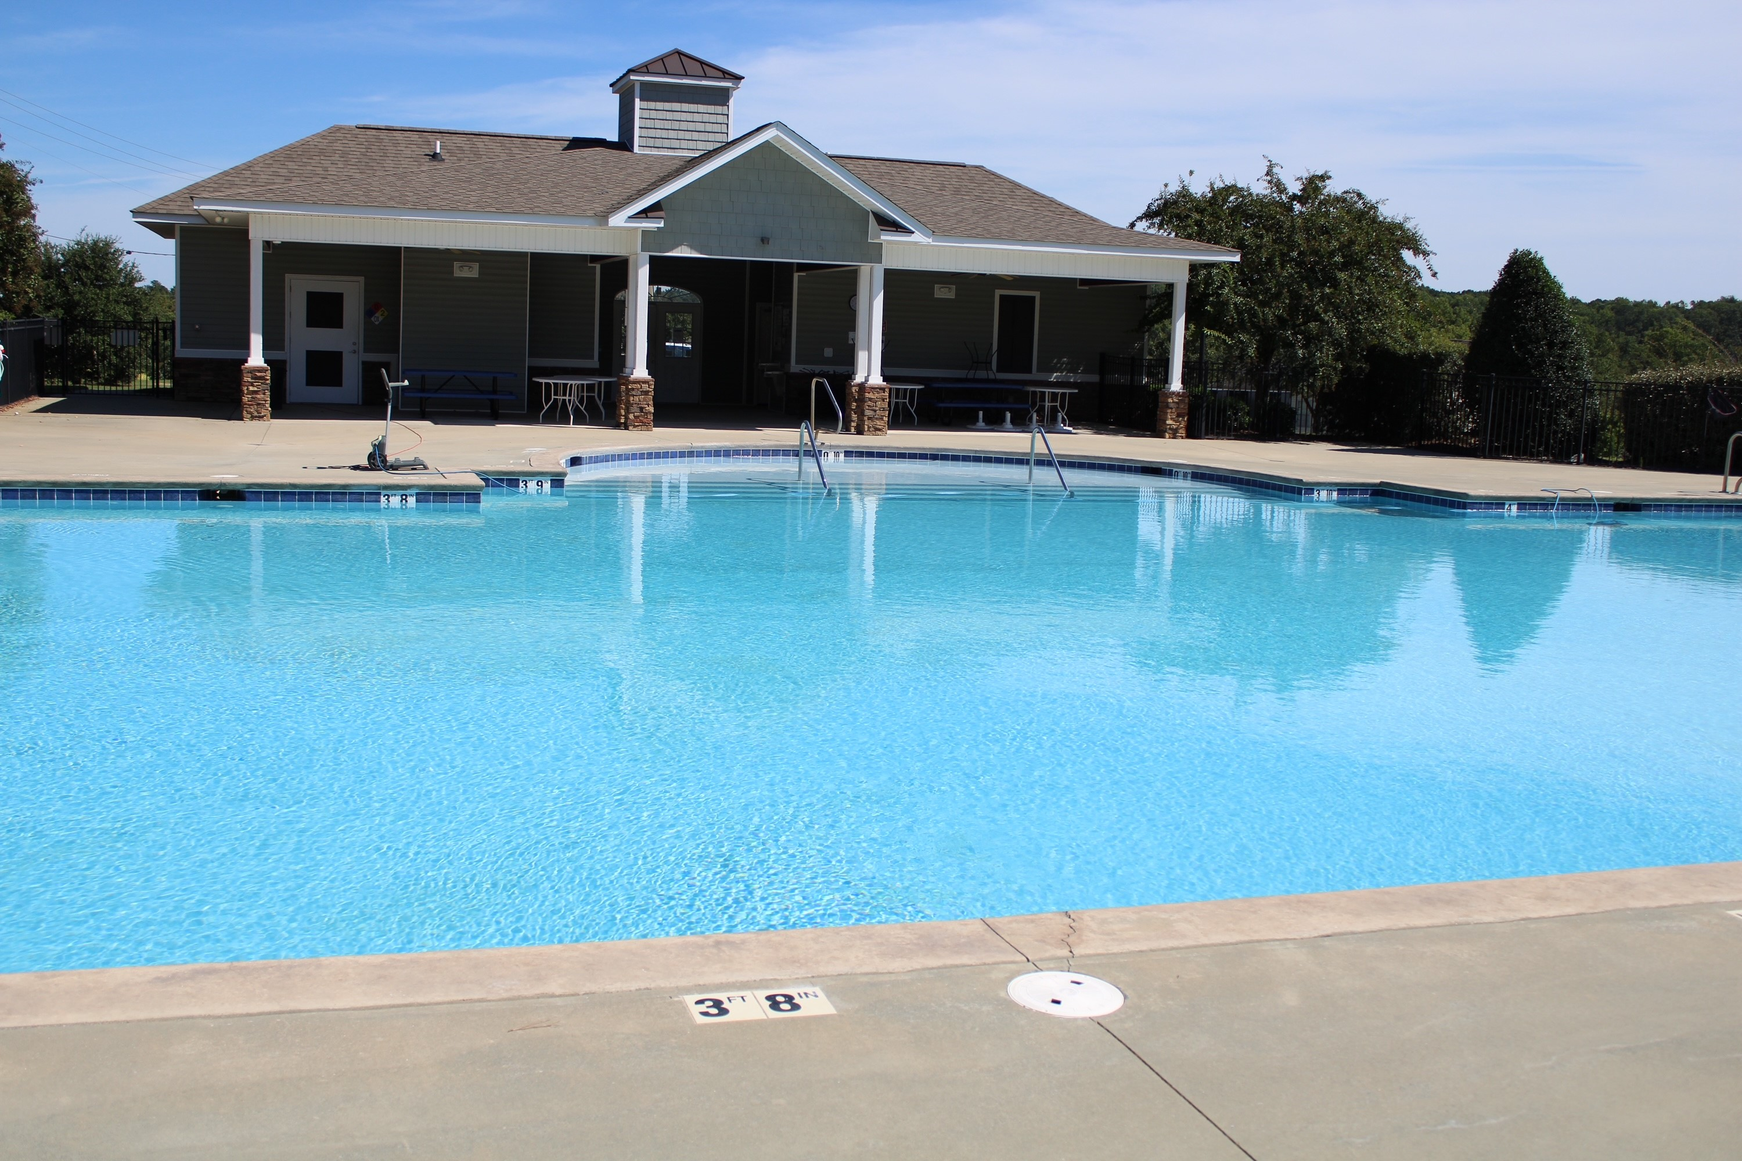
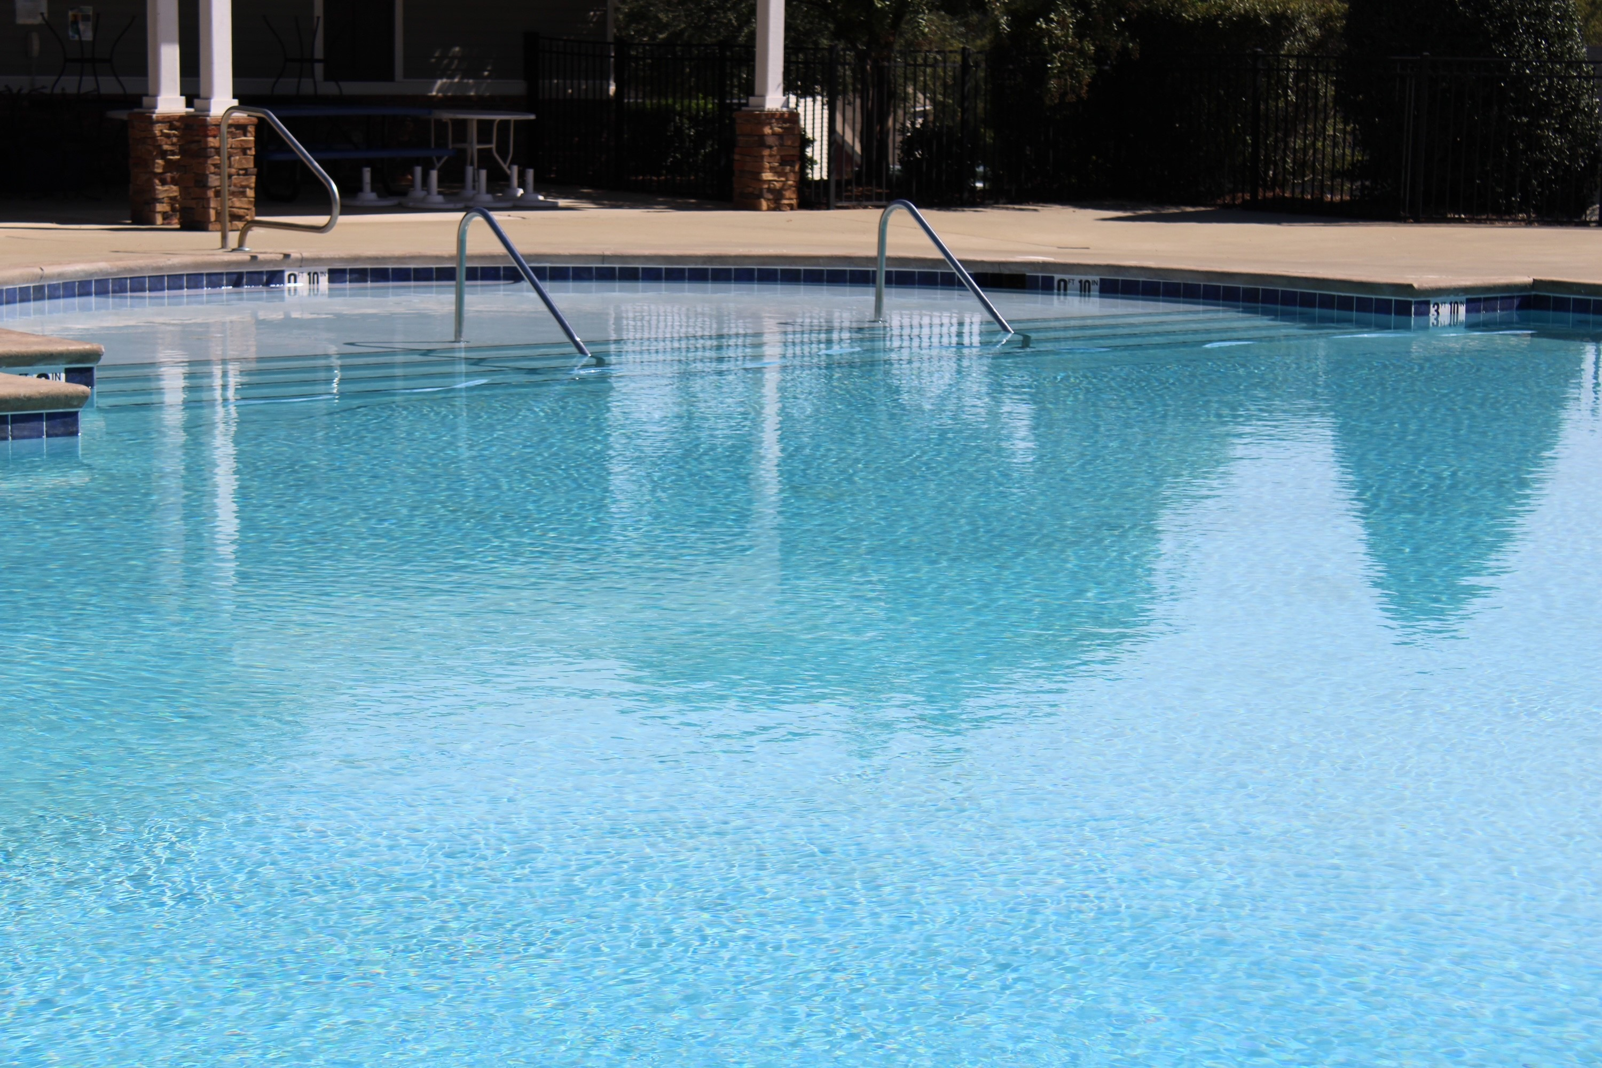
Pool Resurfacing Complete
Notes:
Presenter: Chris A.

Slide 23

Additional Reserve Projects
Continue with the Greenway Repairs as the Budget Allows
Deep trim of bushes along Glen Laurel
Deep trim of wood line along Greenway.
Notes:
Presenter: Sally

Slide 24

Architectural Review Committee
Notes:
Speaker: Chris, Matt & Subhas

Slide 25
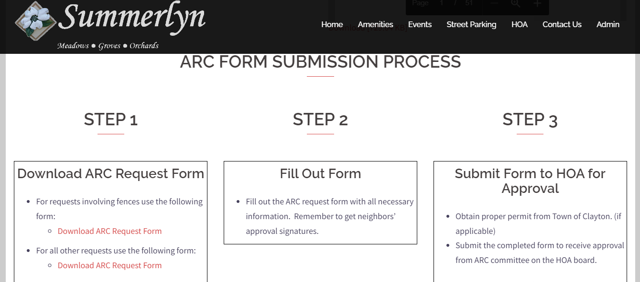
Summerlyn ARC Submission Process
Notes:
Presenter: Chris, Matt, Subhas

Slide 26
Board Membership Voting
Notes:
Presenter: Colie

Slide 27


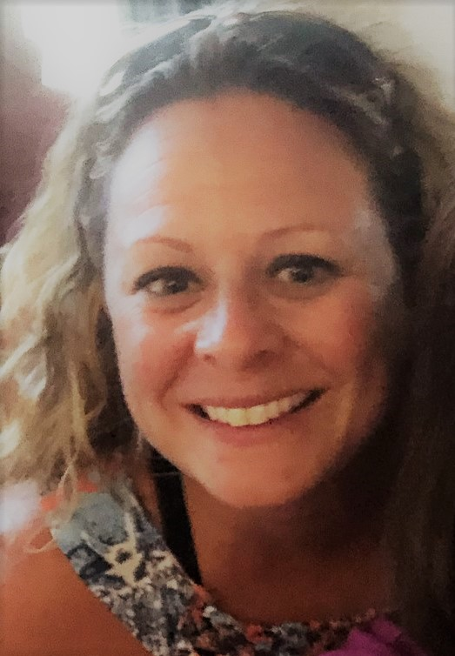

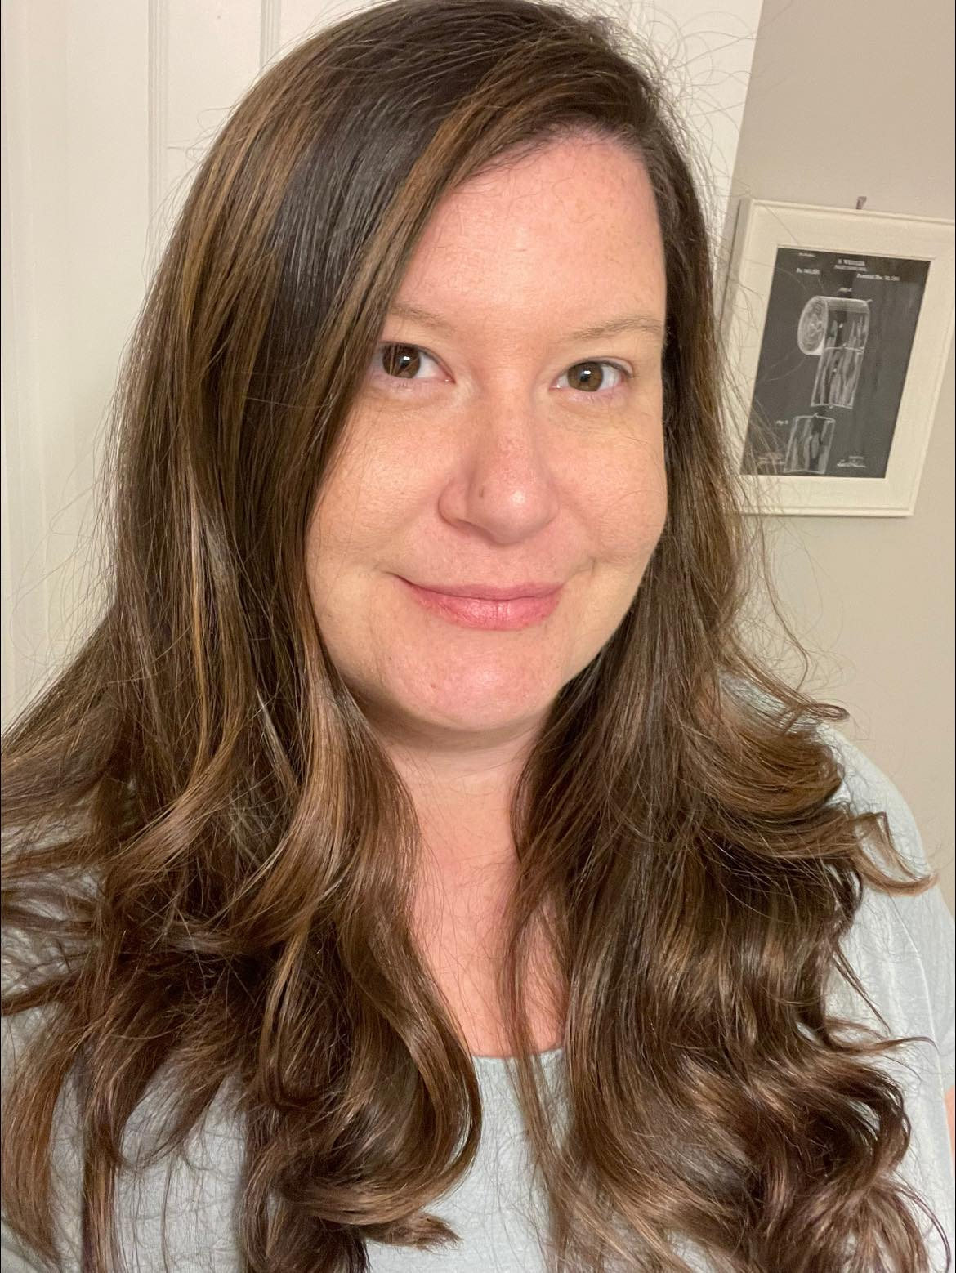
Board of Directors - Openings
Vacant
Vacant
Vacant
Vacant
Kristie Linder
Chris Allard
Sally King
Notes:
Presenter: Colie

Slide 28
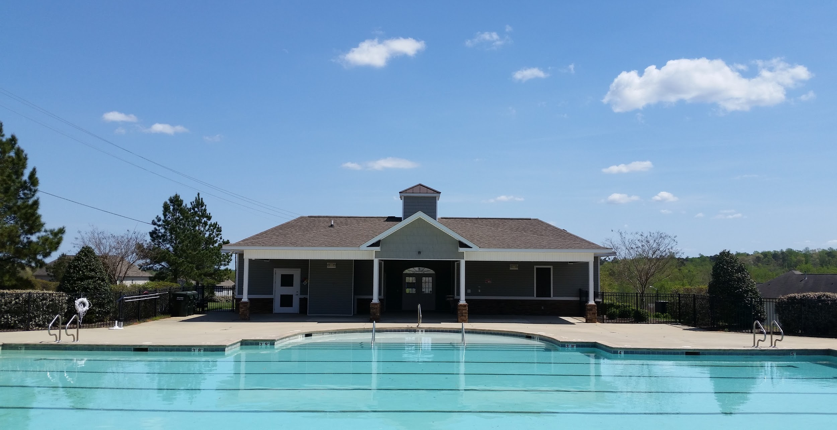
Thank You for Joining Us!
Questions and Comments
Notes:
Presenter: Colie

